Slide 1

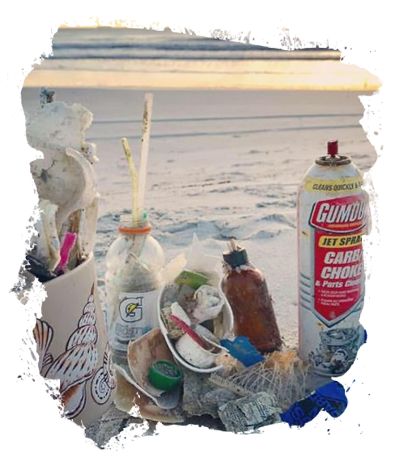
2021 Keep Louisiana Beautiful Conference
Lessons from the
Keep America Beautiful 2020 National Litter Study
David Scott, Ph.D.,
Sr. Director, Research, Monitoring, & Evaluation
October 14, 2021
kab.org/litter-study
Credit: Keep Jacksonville Beautiful

Slide 2

About Keep America Beautiful
As the nation’s largest community improvement organization, Keep America Beautiful believes in the shared responsibility to build and maintain clean, green, and beautiful spaces. That’s why we take action every day to improve and beautify communities across America. Through collective impact, we can ensure that everyone in America lives in a beautiful community.

Slide 3
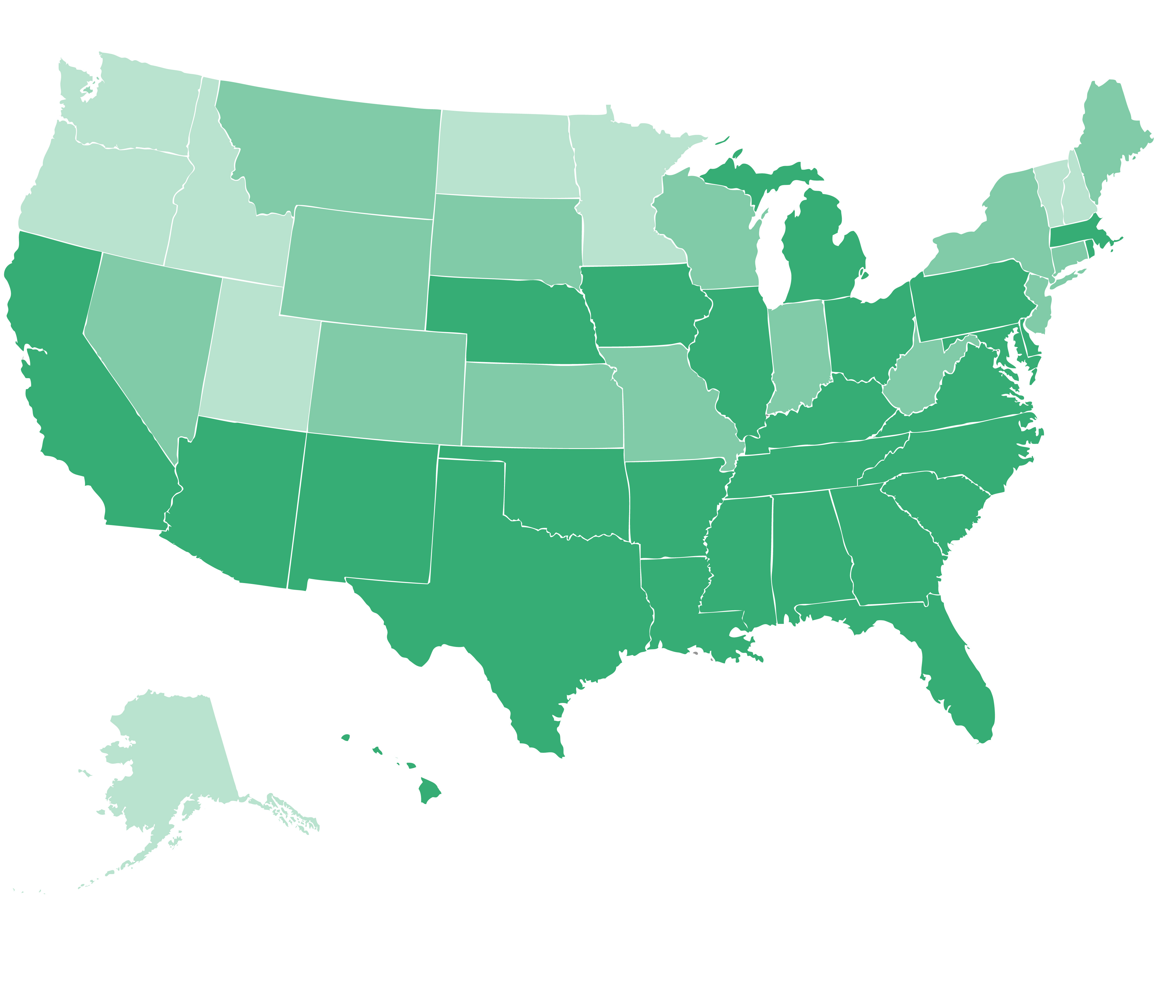
Where & How We Do It: We are Where You Are
National Network for Local Impact
700 Certified Keep America Beautiful Affiliates in 2,500 Communities
Empowering Collective Impact
Common Agenda & Vision
Shared Measurement
Mutually Reinforcing Activities
Shared Communication
Backbone Organization
Centralized National KAB:
Programming
Professional development
Research, strategy, reporting
Local & National Partnerships:
Local government and public relationships for greater impact.
KAB STATE AND LOCAL AFFILIATES
STATES WITH LOCAL AFFILIATES
STATES WITH PARTICIPATING ORGANIZATIONS

Slide 4
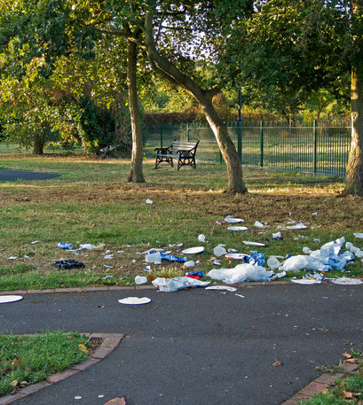
Why Litter Research Matters
For more than six decades, Keep America Beautiful has served as our country’s steward of litter prevention. Litter is more than just a stain on our landscape. It prevents our communities from reaching their true potential. Litter is costly to clean up, impacts our quality of life and economic development, and eventually ends up in our waterways and oceans, & harming the environment.

Slide 5
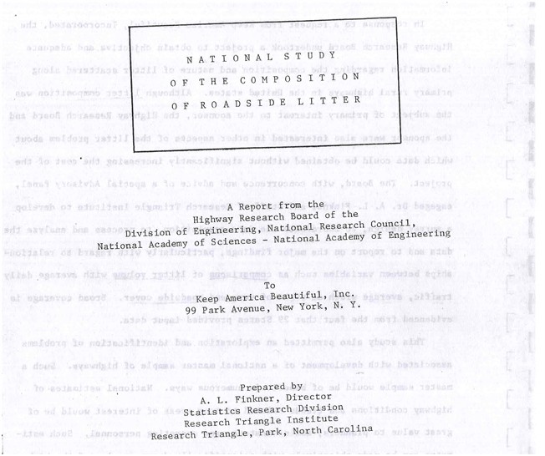
Half a Century of Litter Research
1968: Who Litters—and Why: Litter Awareness and Concern about the Problem of Litter
1969: National Study of Roadside Litter
1971: National Survey of Litter Enforcement
1973: Why people litter and seven primary sources of litter
2002-2004: Cigarette Litter Prevention Program Development
2007: Litter: Literature Review & Analysis
2009: National Visible Litter Survey & Litter Cost Study
2009: Littering Behavior in America
2014-2016: Litter Free Schools and Teacher Efficacy toward Environment and Litter
2015: Littering Categorization at Quick Serve Restaurants
2020: Impact of Media and Infrastructure on Cigarette Litter
2020: Impact of Smoking Bans on Cigarette Litter

Slide 6
Addressing litter is part of the solution to:
Litter
Circularity
Environ-mental health
Community health
Individual Health
Clean water
Environ-mental justice
Climate

Slide 7
Keep America Beautiful 2020 National Litter Study

Slide 8
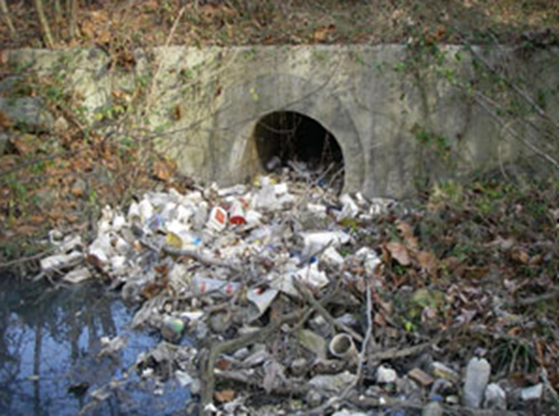
Scientific
Rigor
Since its inception in the 1950s, Keep America Beautiful has been at the forefront of research into litter and mismanaged waste across the globe, making the problems of litter transparent to all, and driving advances that help us understand the problem better.
Research Matters
Advancements
Future Oriented
Litter impacts our lives in many ways
Research drives solutions
Professional studies provide valid, reliable estimates
Foundational technology & data Infrastructure
Enable shared learning & progress
Multi-Method Study
Public Attitudes Survey | Visible Litter Study
Financial Cost of Litter | Behavioral Observations
Plastics: Problems and Solutions • Lessons from the KAB 2020 National Litter Study
Keep America Beautiful
02

Slide 9
Over 80 types of product litter tracked
Includes material composition of products
Enables tracking from 2009 results*
Quantifying emergent litter problems
  PPE
  E-cigarettes
*Roadways only

Slide 10
Incredibly Rich Set of Data Features
Public awareness, attitudes, and behaviors addressing the scope, causes, and sources of litter as well as the responsibility for litter and the role of recycling and policy
The physical attributes and quantities of litter on roadways, near waterways, and in common non-roadway contexts: material sources, categories, size, & images
The features that influence when and why people litter including location type, policies, beautification efforts, infrastructure, traffic/crowdedness, and walkability.
How much it costs the public sector to manage litter annually and the distribution of those costs (prevention, education, abatement, & enforcement)
Foundational Data Infrastructure:
Data collection tools and data architecture that enable future research at scale and continuous improvement through programs & experiments

Slide 11
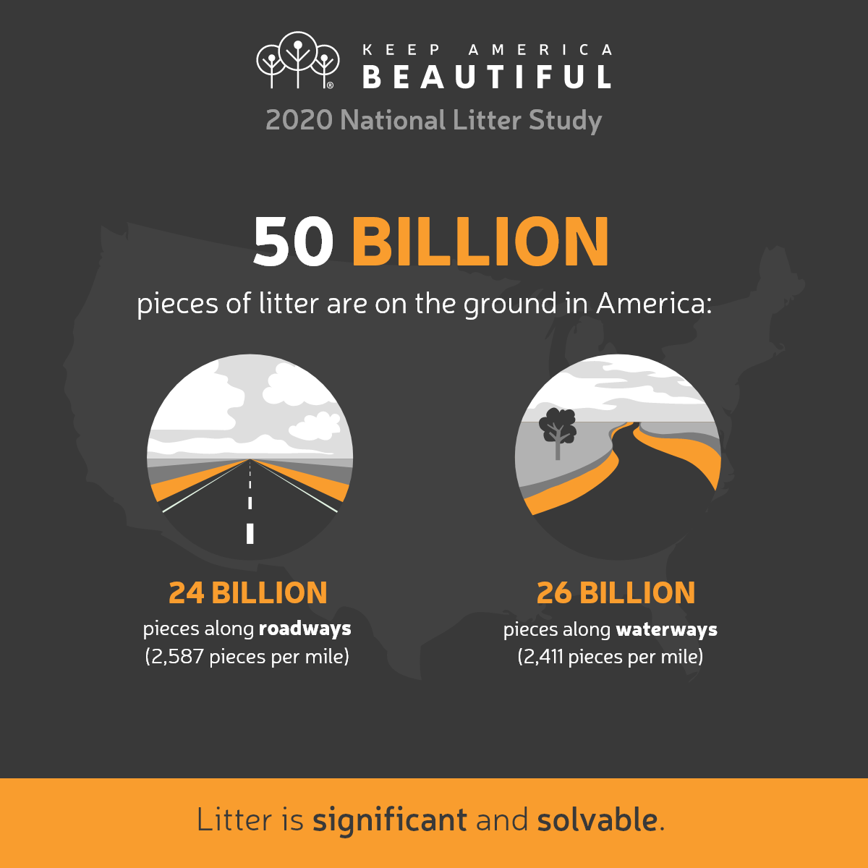
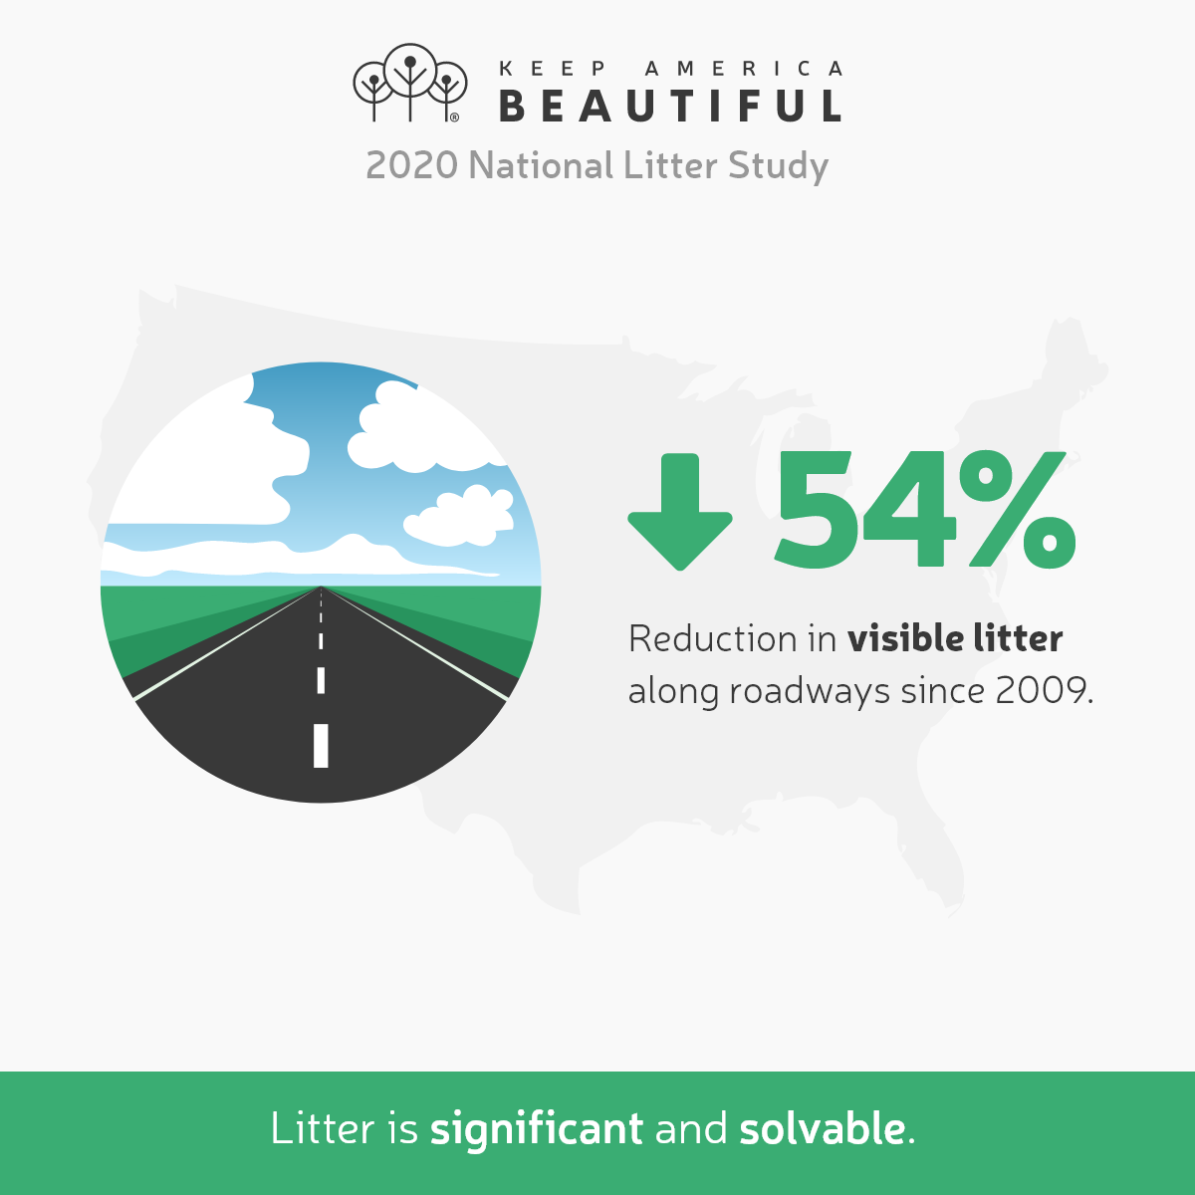
Plastics: Problems and Solutions • Lessons from the KAB 2020 National Litter Study
Keep America Beautiful
12

Slide 12
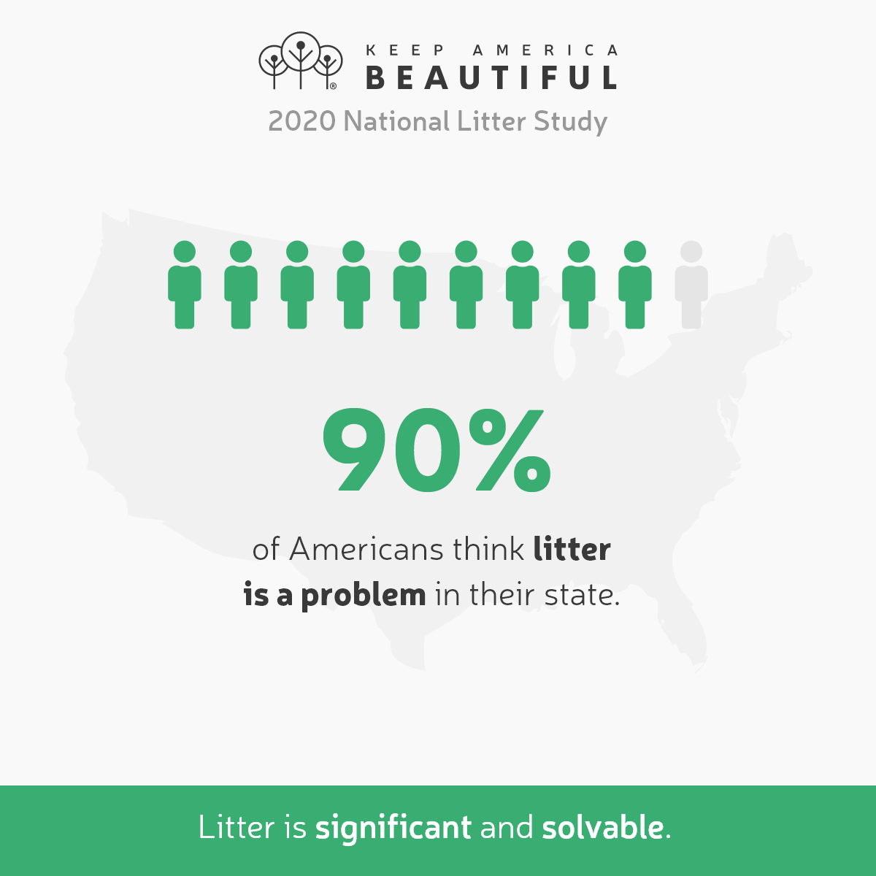

Plastics: Problems and Solutions • Lessons from the KAB 2020 National Litter Study
Keep America Beautiful
13

Slide 13
Top 10 Most Littered Products in the United States
(Roadways and Waterways Combined)
Plastics: Problems and Solutions • Lessons from the KAB 2020 National Litter Study
Keep America Beautiful
07

Slide 14
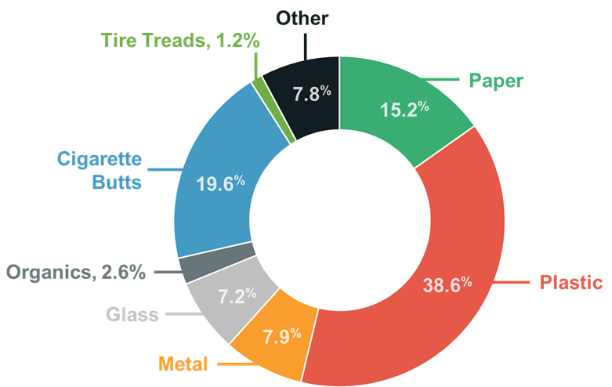
MATERIAL COMPOSITION: More Litter Composed of PLASTIC than Other Materials
50B
pcs.
Plastics: Problems and Solutions • Lessons from the KAB 2020 National Litter Study
Keep America Beautiful
06

Slide 15
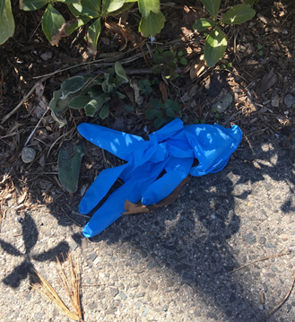
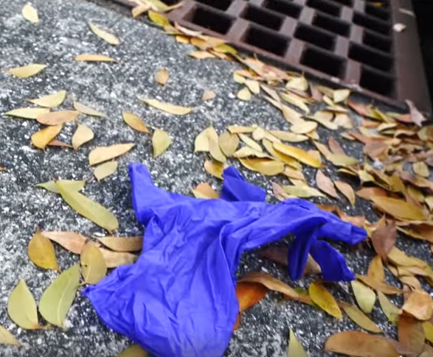
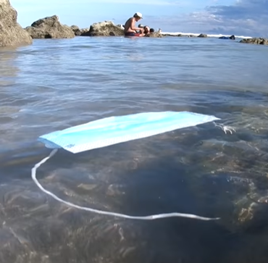
How Litter Moves? Lessons from PPE
Quantifying How Litter Moves to Waterways: PPE is used on land, but PPE litter (207M pieces) easily moves from roadways to waterways through storm drains and by blowing through the natural environment.
Roadway PPE Litter
32% of gloves, 53% of masks
Waterway PPE Litter
68% of gloves, 47% of masks
Plastics: Problems and Solutions • Lessons from the KAB 2020 National Litter Study
Keep America Beautiful
09

Slide 16
Implementing Solutions

Slide 17
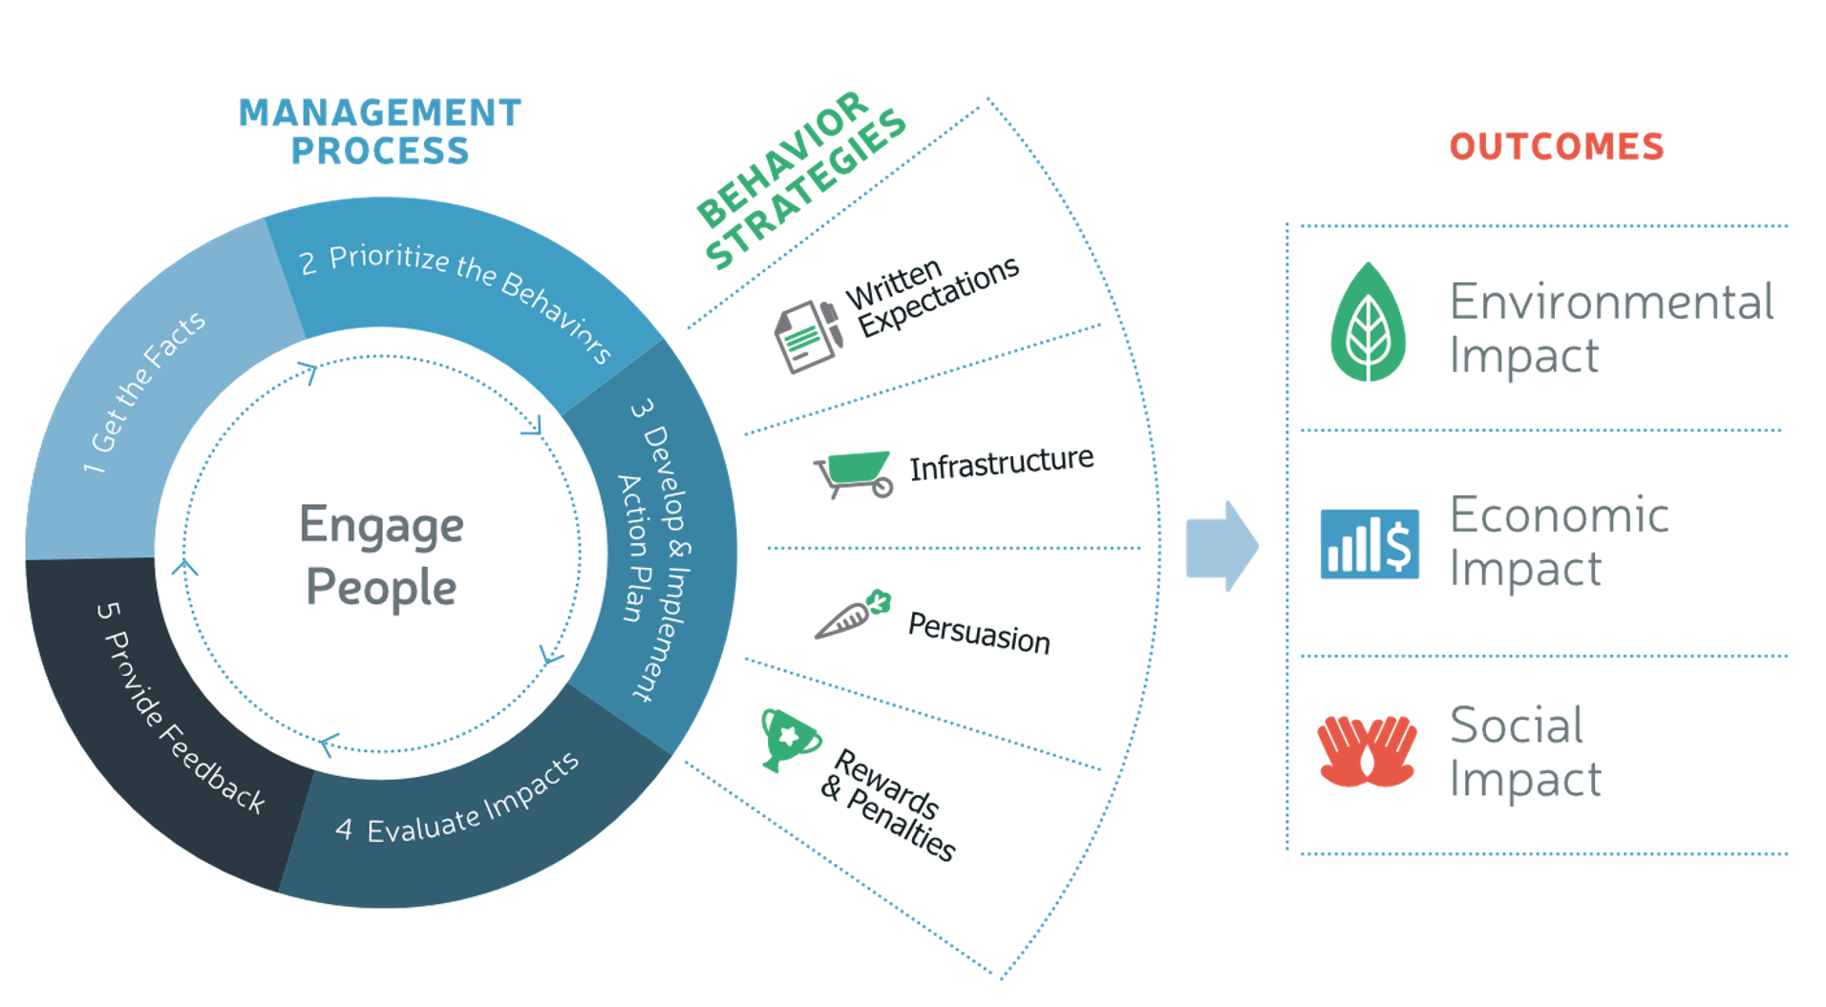
KAB Model for Change
An Integrated Approach to More Beautiful Communities
Application of long-term behavior change strategy through education and place-based interventions such as infrastructure and targeted messaging (reduce barriers to proper disposal)

Slide 18
Integrating Solutions
KAB
AFFILIATES
Infrastructure
Education
Individual & Community Engagement
Technological Innovations
Plastics: Problems and Solutions • Lessons from the KAB 2020 National Litter Study
Keep America Beautiful
10

Slide 19
Implementing Solutions Along Roadways & Waterways
Roadways
Waterways
Type | % Roadway Miles | Littered items /mile | Total Littered Items | % Roadway Litter
Freeways | 2% | 12.6K | 1.7B | 6%
Arterials | 10% | 5.0K | 4.0B | 17%
Collectors | 20% | 3.7K | 6.0B | 25%
Local Roads | 69% | 2.1K | 12.0B | 50%
Total | 100% | 2,9K | 23.7B | 100%
Type | % Waterway Miles | Littered items /mile | Total Littered Items | % Waterway Litter
Large Perennial | 7% | 3.7K | 2.6B | 10%
Small Perennial | 29% | 3.1K | 9.7B | 38%
Intermittent | 65% | 2.0K | 13.6B | 52%
Total | 100% | 2.4K | 25.6B | 100%

Slide 20
Key Issues

Slide 21
Ongoing Topics
Integrating Anti-Litter Efforts, Community Mobilization, Beautification, & Waste Reduction
Public Costs of Litter
Micro Litter
Product Behaviors
Tracking Positive Impact
Policies

Slide 22
Measuring Progress in Communities
Photometric Index
(1970s)
Litter Index (2000s)
Community Litter App
(2022)
Data Driven:
Progress metrics
Decisions on interventions & programming

Slide 23
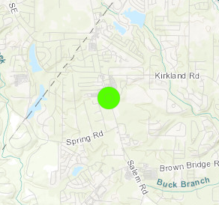

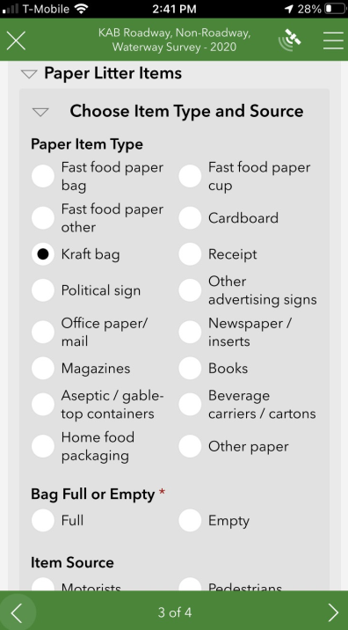

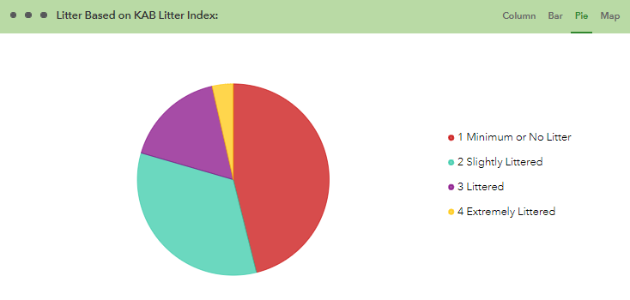
Community Litter Application (in testing)
Geo-based – Easily track same locations over time
Mobile friendly – No special equipment needed
Elevate affiliate and KAB network collective impact
Compatible with Litter Index
Track progress and impact of interventions against litter through user dashboard

Slide 24
How do you want to drive change?

Slide 25





Let’s take a step towards a more beautiful future
For more information about the Keep
America Beautiful 2020 National Litter Study, go to:
www.kab.org/litterstudy
David Scott
dscott@kab.org
Follow us & #DoBeautifulThings
.
Keep America Beautiful | 1010 Washington Boulevard Stamford, CT 06901

