Slide 1

Board Development
2021 State Conference

Slide 2

What is a Board?
The Board of Directors is the governing body of a nonprofit. Individuals who sit on the board are responsible for overseeing the organization’s activities.

Slide 3
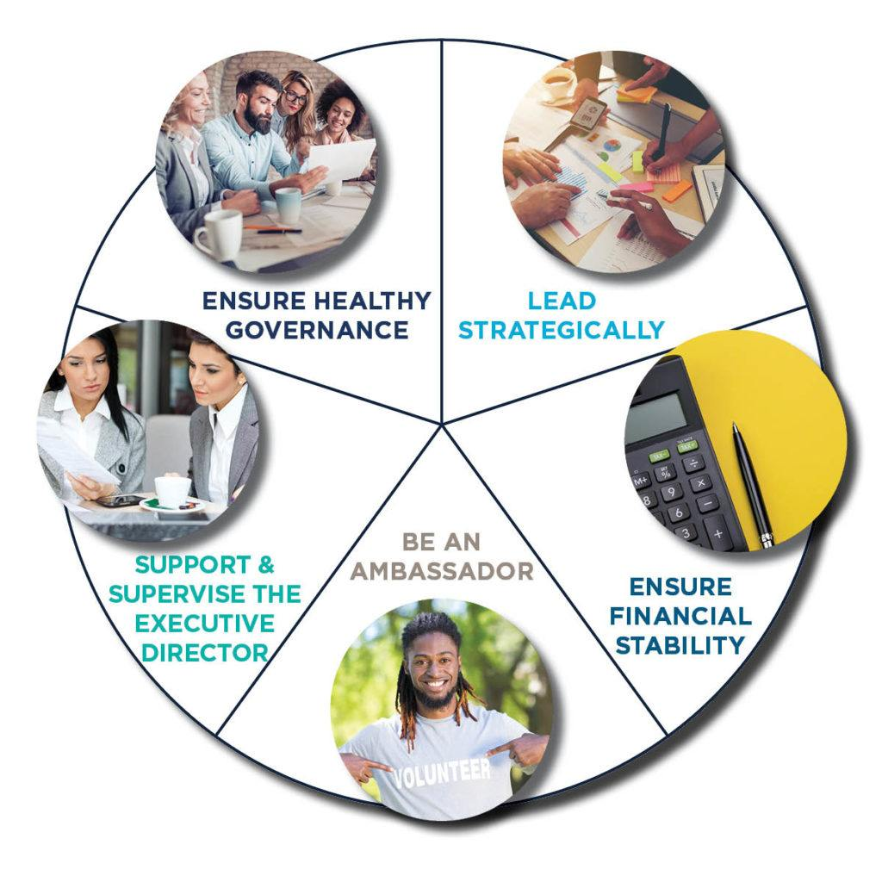
5 Primary Board Responsibilities
Responsibilities

Slide 4

Lead Strategically
Determine mission and purpose.
Ensure effective organizational planning and vision.
Determine, monitor and enhance programs and activities.
Recruit and orient new board members and assess board performance.
Lead Strategically

Slide 5

Ensure Financial Stability
Ensure adequate resources. (funds, staff, volunteers, tech.)
Adopt annual budget
Provide financial oversight
Submit state annual report, federal filings-Form 990, audit
Financial Stability

Slide 6

Be An Ambassador
Recruit community partners and stakeholders.
Advocate for and promote organization.
Speaking engagements.
Donate and participate in fundraising.
Participate in programs/events.
Public face of organization.
Ambassador

Slide 7

Support and Supervise the Executive Director
Hire or help select the executive director
Support the executive director
Assess performance
Support - Supervise

Slide 8

Ensure Healthy Governance
Ensure legal and ethical integrity and maintain accountability.
Articles of Incorporation
Policies
By-Laws
Governance

Slide 9



3 Primary Legal Duties
DUTY OF CARE - Take care of the nonprofit by ensuring prudent use of all assets, including facility, people, and good will
DUTY OF LOYALTY - Ensure that the nonprofit's activities and transactions are advancing its mission. Disclose conflicts of interest. Make decisions that are in the best interest of the nonprofit.
DUTY OF OBEDIENCE - Ensure that the nonprofit obeys applicable laws and regulations; follows its own bylaws; and adheres to its stated purposes/mission.
Board Duties

Slide 10
Recruit and Onboard Intentionally

Slide 11
Have an active standing Board Nominating Committee.
Self-assess board composition to determine your needs. Prioritize diversity, equity and inclusion. Members should reflect the community. Aim for a mix of skills, backgrounds, views and experiences.
Develop a board job description that clearly communicates role and expectation.
Be purposeful and professional when you recruit. What do you want or need them to bring to the board? Do you want them to play a certain role/committee?
Meet in person and communicate the mission, vision
and direction of the organization.
Build with Intention

Slide 12
Board Orientation
A board orientation sets the tone and expectation for the board member-organization relationship.
A Board manual is a reference guide for a new board member.
  Mission statement
  History of organization
  Program description
  Meeting schedule
  Board contact list
  Board committee list
  Job descriptions
  By-laws
  Policies
  Articles of Incorporation
  Annual budget and list of funders
  Staff list
Orientation

Slide 13
Managing a Board

Slide 14
Tips on Board Management
Respect their time.
Ask their opinion and take it when appropriate.
Set them up for success. Provide them with what they need.
Watch for burnout. Use the committee structure.
Manage the organization professionally.
Let them know what a difference they are making by being on the board.
Make sure they understand the vision and mission. Invite them to orientation.
Check in with them in between board meetings.
Give them credit of a job well done in front of others.
Connect them with fellow board members and other stakeholders.
Thank them and then thank them again. Remember they are volunteers too.
Have at least one social event a year just for board members.
Board Management

Slide 15

Board Meetings
Director Should:
Help create and distribute a meeting schedule.
Send meeting reminder a week prior.
Assist in creating an agenda.
Email materials (agenda, financials,
minutes etc.) prior to meeting.
Secure and set up board room.
Arrive early and be prepared.
Do not run the meeting – that is the job
of the Board Chair!
Be positive. Smile. Have fun!
Board Meetings

Slide 16
Board Meetings
Board Members Should:
Submit agenda items ahead of time.
Review materials and financials prior to the meeting.
Attend meetings. Ensure quorum.
Arrive on time. Start meeting on time.
Ask tough questions and have fruitful discussions.
Committees report out and make recommendations to the full board.
Board votes and members support the majority.
Listen more than you speak.
Speak when you have an essential point.
Leave personal and political agendas at the door.
Respect the rules of order.
Have fun!
Board Meetings

Slide 17
Characteristics of a High Performing Board
Strategic – Avoid delving into minutia; understands governance.
Accountable – Follow through on commitments and promises.
Respected – Has the esteem of the community.
Respectful – Demonstrates respect towards all persons; expresses gratitude and shared credit with others.
Team Player – Understands collaboration.
Innovative – Uses ingenuity and resources to solve problems.
Confidentiality – Discussions and documents are to be treated with discretion.
Performance Based – Sets metrics and expects results.
Gratitude – Saying thank you and recognizing the accomplishment
of others goes a long way towards teamwork.
Board Behavior

Slide 18
Discourage Poor Behavior
Ill-Prepared – Meetings require preparation and reading. Recognize these people as they start sentences with, “I just have a question.”
Missing in Action – It takes a quorum to conduct business. Volunteers should attend all duly called meetings.
Doubter – We could never do that.
Personal Agenda – Beware the leader who has a personal agenda instead of respecting the organization’s mission.
Manipulator – Ill intentioned, working for personal gain.
Fraternizer – Does not respect personal boundaries.
Board Behavior

Slide 19
Tips on Board Retention
Respect their time.
Ask their opinion and take it when appropriate.
Engage them in meaningful work.
Communicate the impact of the organization.
Connect them with fellow board members and other stakeholders.
Give them recognition. Acknowledge their contribution.
Show gratitude.
Make it fun.
Board Retention

Slide 20
www.KeepLouisianaBeautiful.org | 985.502.9024
903 Coffee Street | Mandeville | 70448

