Slide 1
RECYCLING
and Beyond
LAFAYETTE PARISH SCHOOL SYSTEM 2016-2017
Amanda Waddle Catherine S Comeaux
Notes:
Hello, I am Catherine Comeaux, a Lafayette Parish Public School parent and a member of No Waste LA. Last year, Amanda Waddle also a member of No Waste LA and a former LPSS parent spoke to this event about the then brand new recycling services being implemented in 20 school and office sites in the Lafayette Parish Public School System as part of the new waste management contract for the schools. The day of her talk was the actual day on which our daughters’ school, Woodvale received their recycling dumpster.
We are here today to let you know how the first year went - how the program was implemented, its successes and challenges as well as the opportunities for education which it has provided.

Slide 2
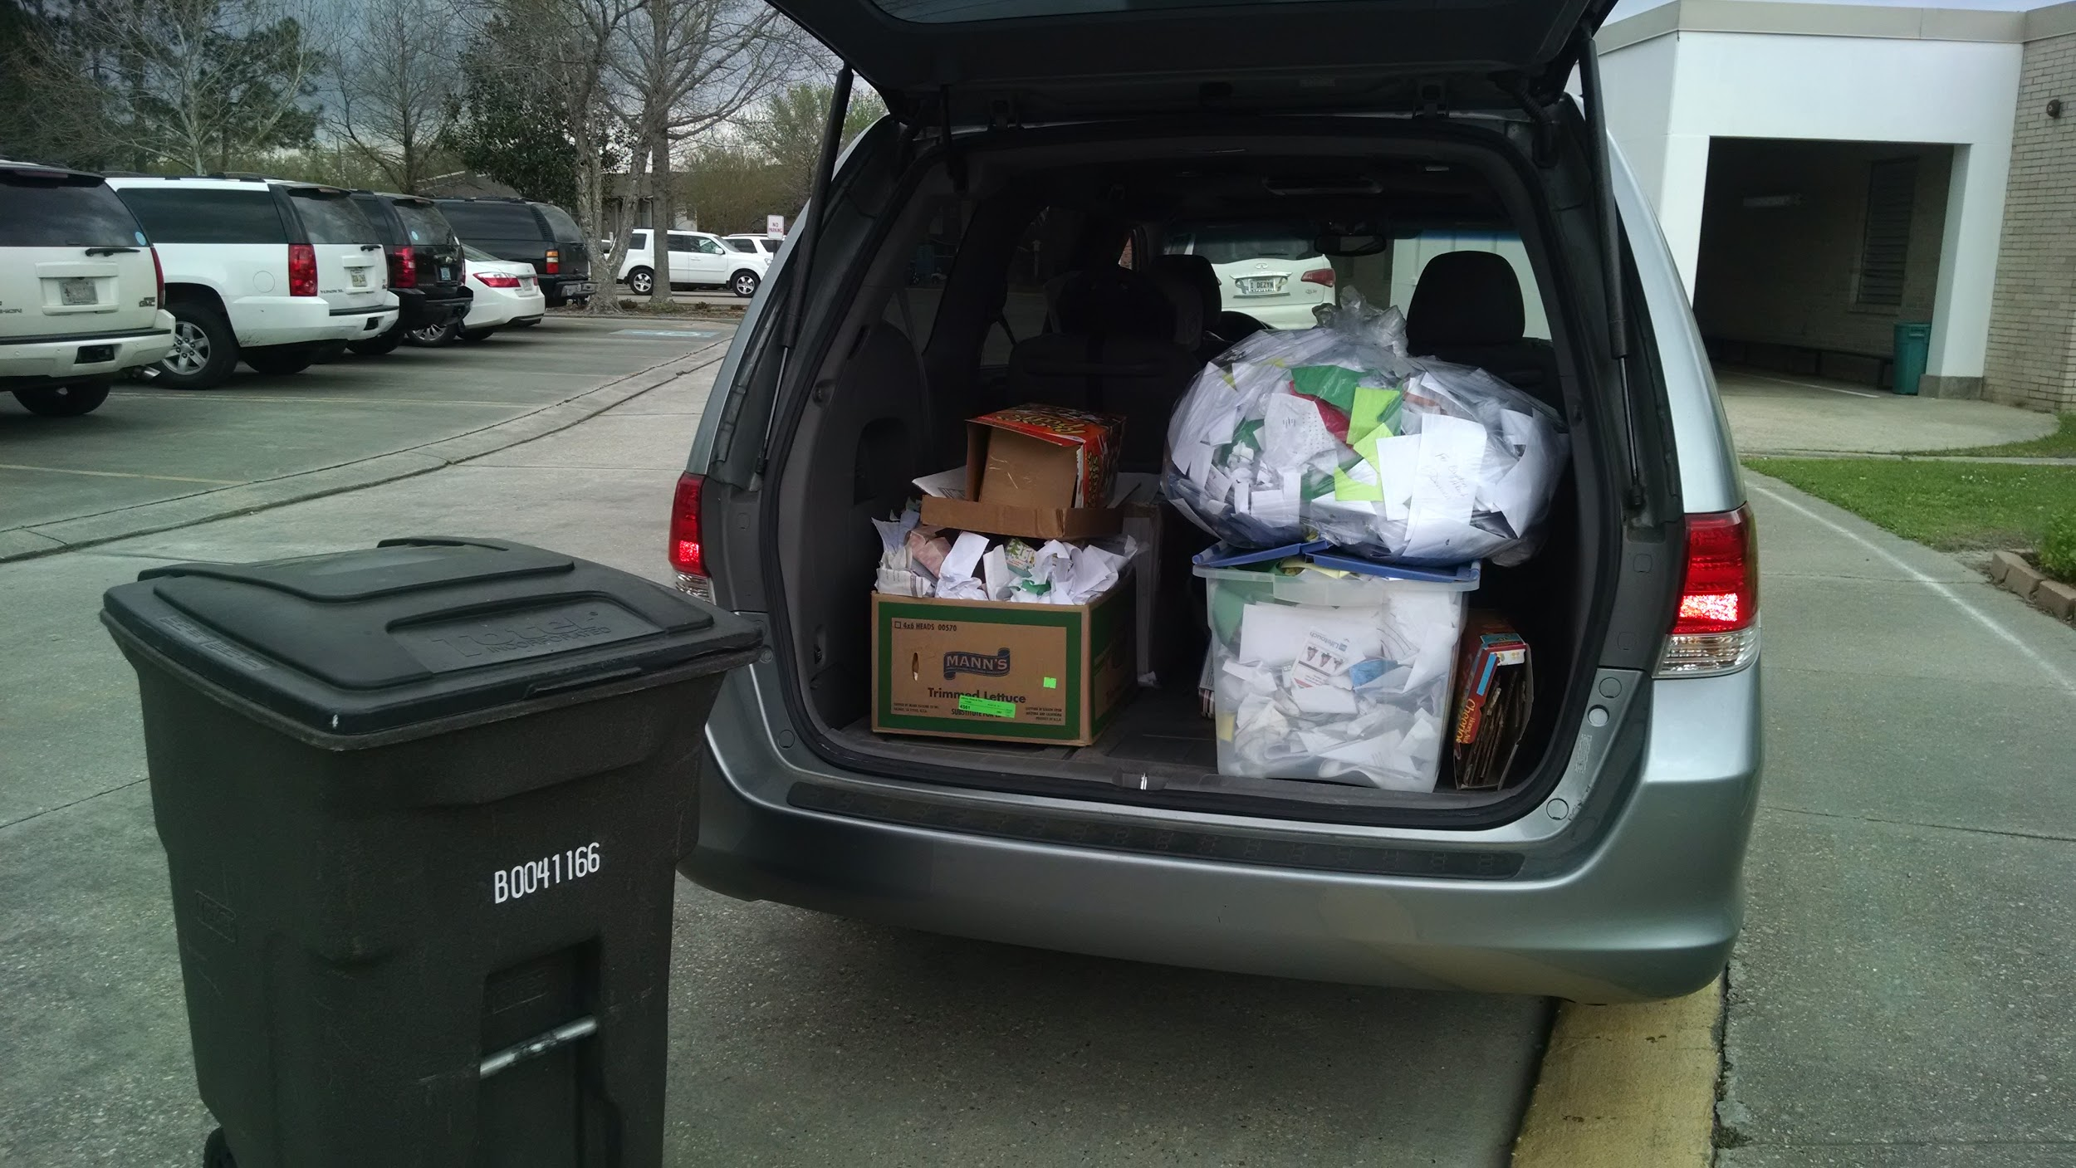

RECYCLING IN THE PAST: VOLUNTARY, SPORADIC AND HARD WON.
Notes:
Prior to the current recycling contract with Waste Management, there were various recycling efforts made at several LPSS schools. Informal inquiries tell us that some schools had volunteered a few years ago for a pilot recycling program that the previous waste handler provided at no extra charge to the district. But as costs rose, the schools were told they would have to start paying for the recycling service and many of them were unable to do so. One school, Lafayette High, through the diligent efforts of faculty and staff, was able to find the funding and support to be able to continue the service. But other schools did not. Some teachers would carry recyclables home in their cars. Parents like Amanda and I even started the pilot program Amanda spoke of last year which yielded data to help us convince the school board that they needed to put recycling into their waste management contract.

Slide 3
Why DISTRICT SUPPORTED recycling?
More competitive bid process for recycling services.
Consistent message PreK - High School.
Information sharing / support.
Notes:
When Amanda and I started the parent-led pilot paper recycling program at Woodvale we knew that for it to be a lasting feature in the school system, it would need to be formalized - not just at our kids’ school but at all schools for three reasons: waste handling companies can make more competitive bids when they have a larger volume of clean recyclables which makes it more affordable for the school system AND students would need to be receiving a consistent message at each level of their schooling: we recycle PreK to Senior year because it is the best way to handle our valuable waste stream. In addition, if all schools are participating - the challenges are faced by all and with that there is greater potential for finding solutions to these challenges through information sharing.

Slide 4
SAVINGS REALIZED via 38.28 tons of LPSS RECYCLING:
650 trees,
14,500 gallons of oil,
114 cubic yards of landfill space,
153,000 kilowatts of energy,
and 268,000 gallons of water
Notes:
Ms. Yerino, the science teacher at Woodvale says, “Having the recycling program has made recycling come alive for the students. They can see that materials are being recycled every day. When they learn recycling a ton of paper saves 17 trees, 380 gallons of oil, three cubic yards of landfill space, 4000 kilowatts of energy, and 7000 gallons of water, they can literally see Woodvale contributing towards that goal.”
And it has considering that over the course of the year, LPSS recycled 38.28 tons of waste, averaging almost 20% of the total commercial recycling volume in Lafayette.
The inclusion of recycling in the district wide waste handling contract showed that the school board recognized recycling as a priority - a real and necessary part of the curriculum to be demonstrated all year long, not just as idea to be discussed on Earth Day.
Ms. Yerino: When we figure there are over 90,000 elementary schools in the U.S., children can see what a difference just recycling in schools can make!

Slide 5
DIVERTING WASTE CAN SAVE MONEY
$25,000annually
Notes:
Because the participating schools were able to reduce dramatically the waste going into their dumpsters, Waste Management recommends downsizing the number of dumpsters at these sites, which will allow the school system to realize $25,000 in savings BUT ONLY if dumpsters are removed / downsized. Commercial recycling will typically be an added cost unless there is a plan for downsizing the trash dumpsters and the waste going into them.
The LPSS staff is expanding to all schools and facilities in the parish, but this will take some time to implement as they are working to be sure that Waste Management has proper materials before pushing any information out. In the initial implementation phase last year, there were hold ups at some of the schools because more schools had requested participation than originally planned for and Waste Management was caught off guard in being able to provide rolling carts and appropriate recycling dumpsters.
While we are more than excited to see this expansion of recycling take place, we know that there are challenges that need continuous monitoring and addressing.

Slide 6
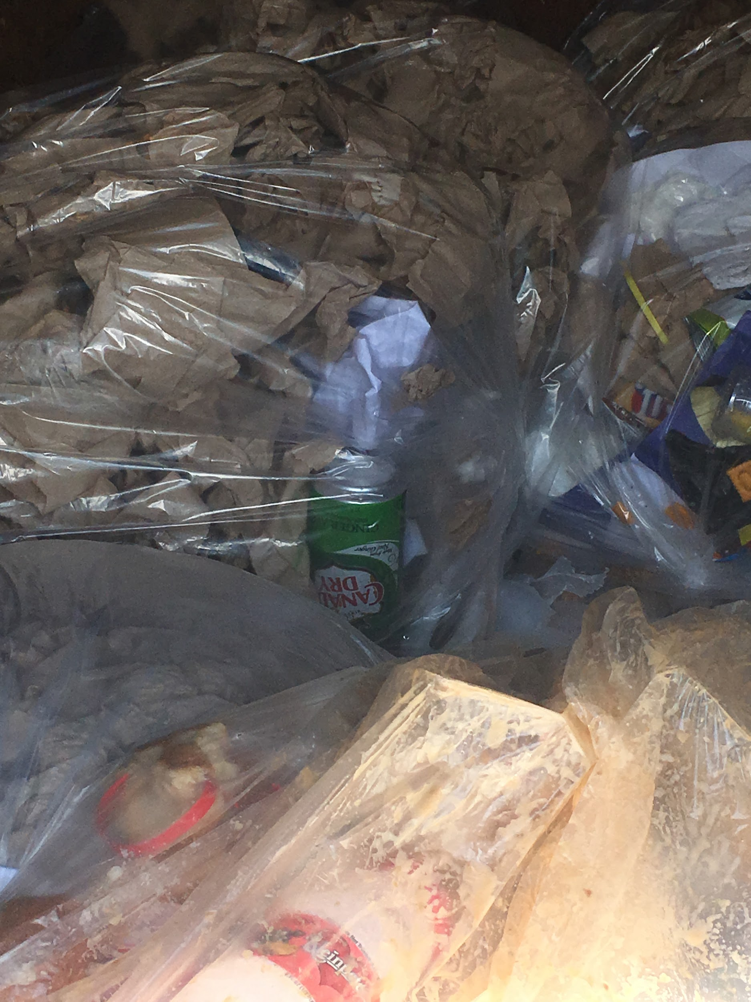

CHALLENGES
Logistics
Plastic milk bottles
Unflattened boxes
Contamination
Notes:
There were really 4 challenges we faced (I continued to volunteer with the recycling at Woodvale throughout last year - I was there at least twice a week and helped empty the paper recycling and checked in the solid waste dumpster to see how full they were).

Slide 7
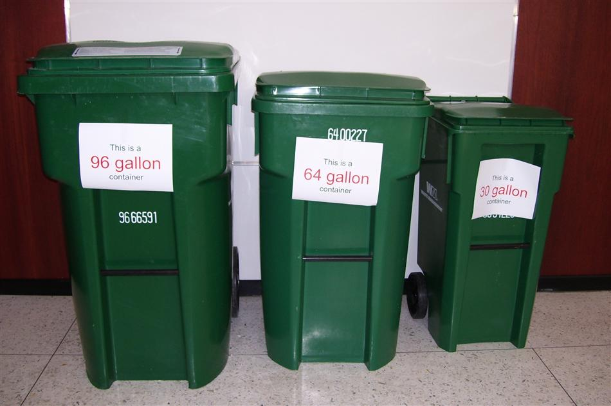
Logistics
Notes:
Waste Management received the solid waste/recycling contract and they provided the schools who were recycling with 96 gallon rolling carts to use to get the paper from the classrooms to the recycling dumpster (which was placed right beside the solid waste dumpster -this is important that they are together). The custodial staff was eager to make the transition and keep all recyclable material out of the solid waste dumpster but they had a hard time getting the paper from these large and heavy 96 gallon rolling carts from the hallways to the recycling dumpster. Woodvale placed a 96 gallon rolling cart down each of the 5 major hallways and the recycling leader from each classroom emptied the recycling box from their classroom into the 96 gallon rolling cart and then the custodial staff emptied the sometimes full 96 gallon cart. There was no way to lift these carts so instead they would transfer the paper from the 96 gallon cart into the recycling dumpster - this is time consuming and difficult. We made WM aware that smaller cart would work better but as far as I know there were no changes to this system.

Slide 8
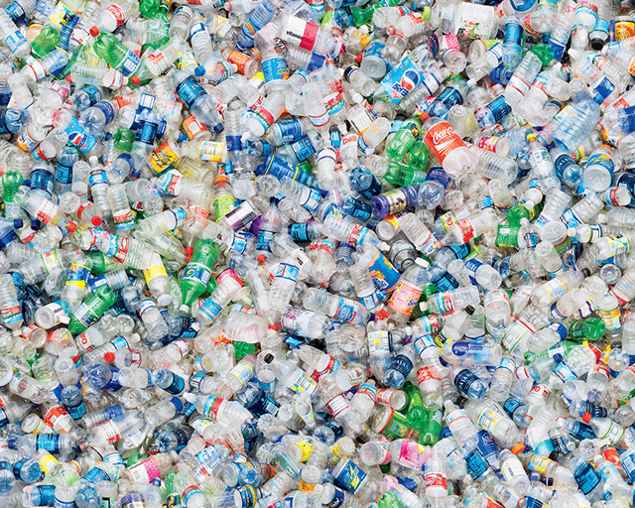
Plastic Milk Bottles
Notes:
Plastic #2 milk bottles - over 300 are used at lunch daily at woodvale but there is no system in place to rinse (which was required by WM) these and keep them separate from the solid waste and recycled therefore they were not getting recycled. I proposed a few possibilities which mostly included the older school kids being involved in rinsing them and placing them in a separate bin and custodial staff taking them to the recycling dumpster. These plastic bottles take up a large amount of space in the solid waste and are a missed opportunity for the schools to reduce this material. Woodvale's cafeteria is challenged by space and lack of a sink to empty and rinse. Dr. LeBlanc, LPSS science specialist who is in charge of recycling is hopeful to get a system in place to get these plastic bottles recycled this year.

Slide 9
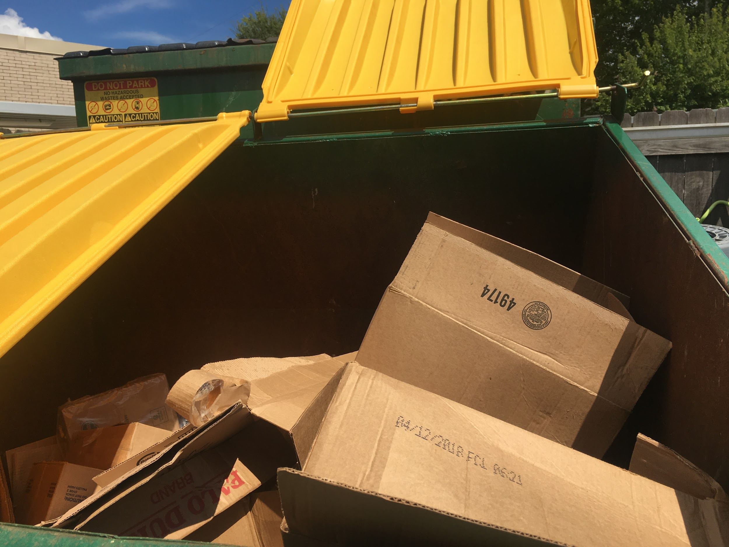
Unflattened boxes
Notes:
The custodial and cafeteria staff often did not flatten boxes and as a result the recycling dumpster would be full or overfull and recyclable material would end up in the solid waste dumpster. Repeated reminders that the staff should flatten boxes did help.

Slide 10
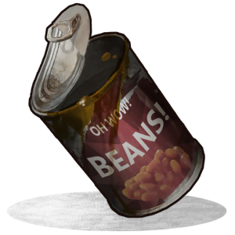
CONTAMINATION: misplaced trash / mishandled recyclables
Notes:
Very infrequently regular "trash" was placed in the recycle dumpster. This happened a couple times by the after school group who was either unaware or just didn't notice. Contamination occasionally occurred (although WM said that the schools recycling was the most uncontaminated that they picked up). Plastic film or soft plastics were placed in the recycled bin occasionally and sometimes the large metal tin cans were not rinsed out enough. This was infrequent and a friendly reminder was all that it took, until it happened again and then a reminder occurred.

Slide 11
GOAL: WASTE LESS
Notes:
One of the broader challenges is to refocus on the goal which recycling is supposed to address: the reduction of waste going to landfills and incenerators. The goal is NOT to recycle MORE but to waste less. It is in this that we find the educational opportunities.

Slide 12
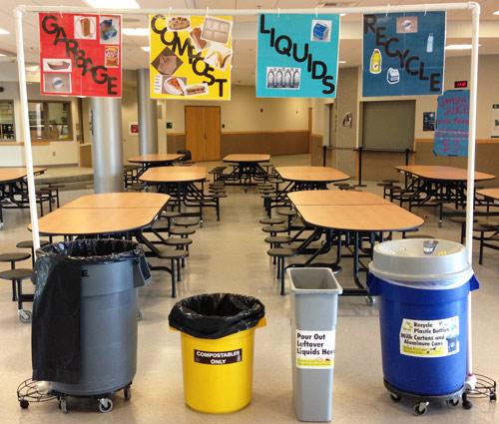
In the cafeteria
GARBAGE COMPOST LIQUIDS RECYCLE
Notes:
In the Cafeteria: The usage of durable plates and silverware in school cafeterias is becoming less common across the US. While our school district continues to use them, they are often left on the shelves in favor of Styrofoam plates and plastic utensils. Broken dishwashing equipment and lack of staff are often cited as grounds for turning to Styrofoam. As students eat on and throw away a product that is highly toxic to produce and eternally pernicious in the environment, they learn that this is acceptable for convenience. Highlighting and promoting the use of durables would reinforce the REUSE aspect of waste reduction.
Another LPSS tradition that we need to highlight is the continued practice of scratch cooking when the trend across the nation is moving towards more pre-prepared foods with lots of excess packaging involved.

Slide 13
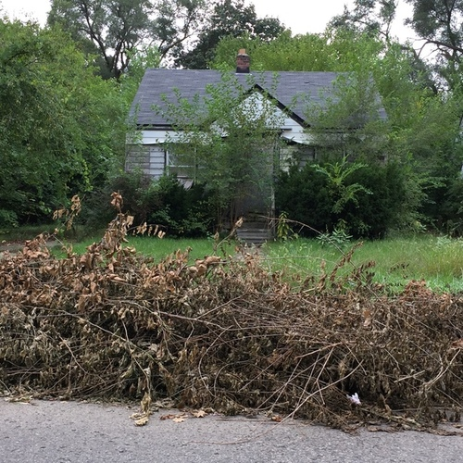
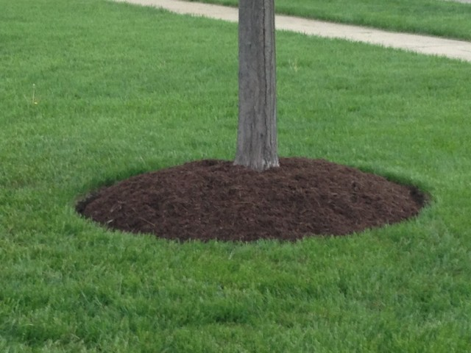
In the school yard
Notes:
In the school yard: According to LPSS policy, all yard waste from schools is to be picked up and taken to the city’s yard waste composting facility so as not to take up space in the dumpster and end up in the landfill. The city composting facility also offers the finished compost for free to use as mulch. The use of this compost on school campus would be a perfect example of a closed loop recycling system and an opportunity for educating the students about using recycled products.

Slide 14
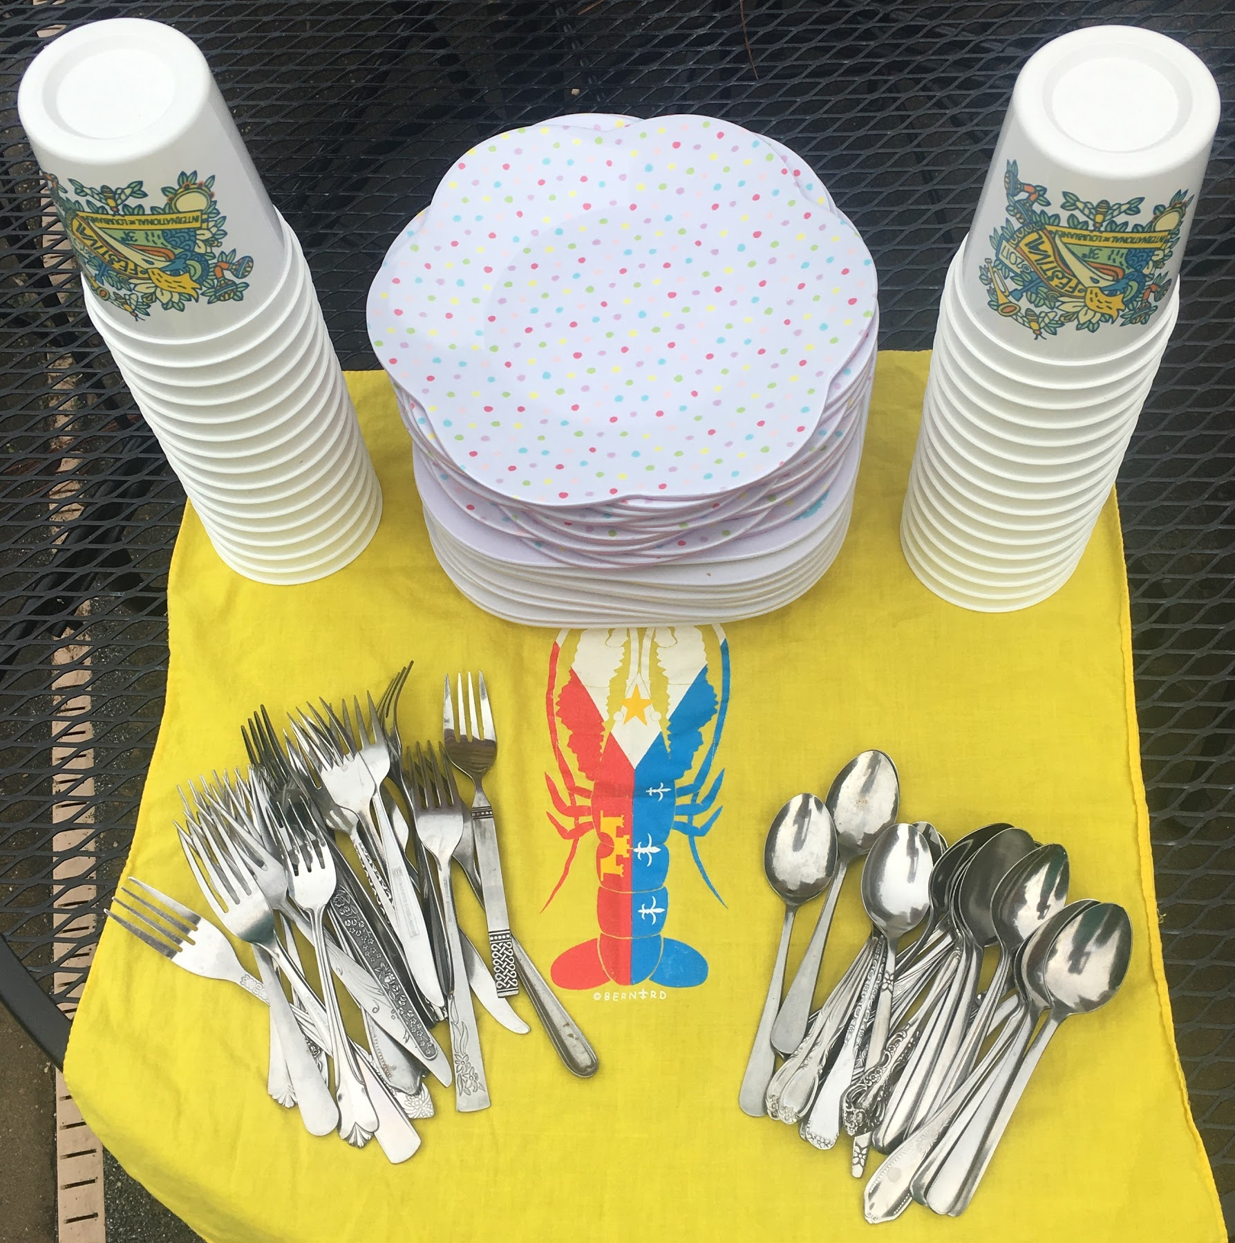

In the classroom
Zero Waste Party Kit
Notes:
While students are throwing their used papers in the classroom recycling bin they are learning why this is important through Rocksey’s Toolbox which Project Front Yard, in conjunction with Keep Louisiana Beautiful and Keep Lafayette Beautiful offers to Lafayette Parish schools. It’s a free environmental education curriculum: Rocksey’s Toolbox, Keep Louisiana Beautiful’s education program contains 10 environmental lesson plans, hands-on activities for a variety of grade levels, fun activity sheets, GLE matches, and additional resources. Topics include; defining litter, timeline of trash, litter decomposition, watershed, clean water, effects on wildlife, plastics, reducing, reusing, recycling and civic responsibility.

Slide 15

Catherine S. Comeaux
schoefflercomeaux@gmail.com
No Waste Lafayette
Notes:
With the school system’s implementation of district wide recycling, they have made an important step in moving the entire community forward in the realm of waste reduction - through actual practice as well as by educating students who will affect future policies and goals of our state. The challenge will be to improve recycling and look to other means of reducing the amount of waste going to landfills. As I stated in my introduction, I am a founding member of No Waste Louisiana and head up the Lafayette Chapter which closely follows waste reduction in the Lafayette area. We have a No Waste Lafayette page which can be found on FB. I can be reached at this email address should you have any waste reduction solutions to share.

