Slide 1

Making the Case for Recycling:
Tracking the progress and cost effectiveness of University of Louisiana at Lafayette’s Recycling and Waste System
Notes:
Maintain and to nurture the conditions on which life depends.

Slide 2
Timeline of UL Recycling and Waste System
Student Government Association works with new President, Dr. Joseph Savoie, to pilot recycling paper, plastic bottles, aluminum cans and cardboard in Martin Hall.
Fall 2010

Slide 3
Timeline of UL Recycling and Waste System
Martin Hall and Foster Hall compete in a month long recycling competition.
Spring 2011
Student Government Association works with new President, Dr. Joseph Savoie, to pilot recycling paper, plastic bottles, aluminum cans and cardboard in Martin Hall.
Fall 2010

Slide 4
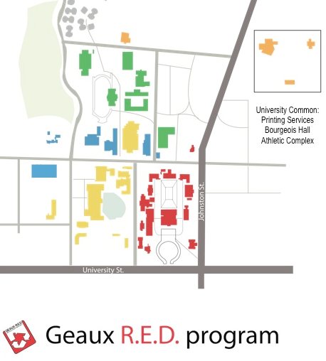
Timeline of UL Recycling and Waste System
Martin Hall and Foster Hall compete in a month long recycling competition.
Spring 2011
Student Government Association works with new President, Dr. Joseph Savoie, to pilot recycling paper, plastic bottles, aluminum cans and cardboard in Martin Hall.
Fall 2010
Fall 2011
Recycling is established
in offices of all
“Zone 1” Buildings.

Slide 5
Timeline of UL Recycling and Waste System
Martin Hall and Foster Hall compete in a month long recycling competition.
Spring 2011
Student Government Association works with new President, Dr. Joseph Savoie, to pilot recycling paper, plastic bottles, aluminum cans and cardboard in Martin Hall.
Fall 2010
Recycling is added to offices
of all
“Zone 2” Buildings.
Spring 2012
Fall 2011
Recycling is established
in offices of all
“Zone 1” Buildings.

Slide 6
Timeline of UL Recycling and Waste System
Martin Hall and Foster Hall compete in a month long recycling competition.
Spring 2011
Student Government Association works with new President, Dr. Joseph Savoie, to pilot recycling paper, plastic bottles, aluminum cans and cardboard in Martin Hall.
Fall 2010
Recycling is added to offices
of all
“Zone 2” Buildings.
Spring 2012
Fall 2012
Recycling is added
to offices of all
“Zone 3” Buildings.
Fall 2011
Recycling is established
in offices of all
“Zone 1” Buildings.

Slide 7
Timeline of UL Recycling and Waste System
Martin Hall and Foster Hall compete in a month long recycling competition.
Recycling is added to offices of all “Zone 4” Buildings.
Spring 2011
Spring 2013
Student Government Association works with new President, Dr. Joseph Savoie, to pilot recycling paper, plastic bottles, aluminum cans and cardboard in Martin Hall.
Fall 2010
Recycling is added to offices
of all
“Zone 2” Buildings.
Spring 2012
Fall 2012
Recycling is added
to offices of all
“Zone 3” Buildings.
Fall 2011
Recycling is established
in offices of all
“Zone 1” Buildings.

Slide 8
Timeline of UL Recycling and Waste System
Martin Hall and Foster Hall compete in a month long recycling competition.
Recycling is added to offices of all “Zone 4” Buildings.
Spring 2011
Spring 2013
Student Government Association works with new President, Dr. Joseph Savoie, to pilot recycling paper, plastic bottles, aluminum cans and cardboard in Martin Hall.
Fall 2010
Recycling is added to offices
of all
“Zone 2” Buildings.
Spring 2012
Recycling is added to offices of all
“Zone 5” Buildings.
Fall 2013
Fall 2012
Recycling is added
to offices of all
“Zone 3” Buildings.
Fall 2011
Recycling is established
in offices of all
“Zone 1” Buildings.

Slide 9
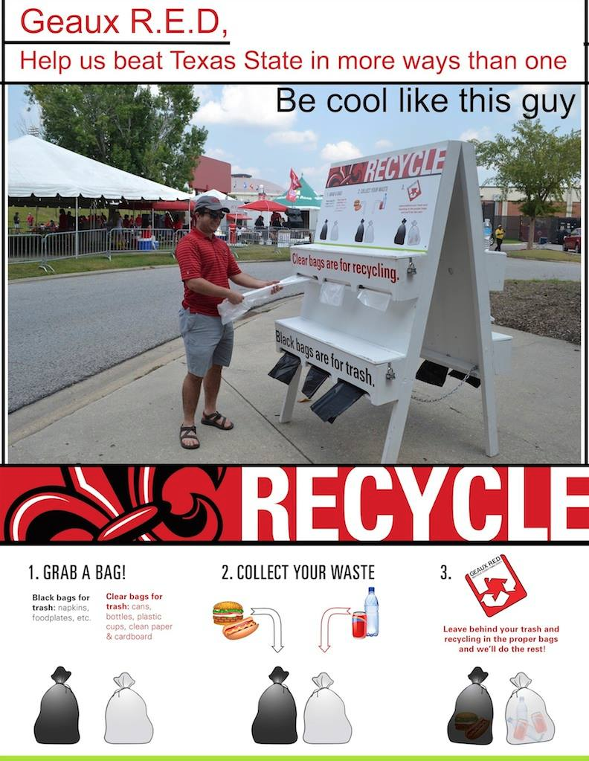
Timeline of UL Recycling and Waste System
Martin Hall and Foster Hall compete in a month long recycling competition.
Recycling is added to offices of all “Zone 4” Buildings.
Spring 2011
Spring 2013
Recycling is done for the first time during tailgating with self service model.
v
Fall 2013
Student Government Association works with new President, Dr. Joseph Savoie, to pilot recycling paper, plastic bottles, aluminum cans and cardboard in Martin Hall.
Fall 2010
Recycling is added to offices
of all
“Zone 2” Buildings.
Spring 2012
Recycling is added to offices of all
“Zone 5” Buildings.
Fall 2013
Fall 2012
Recycling is added
to offices of all
“Zone 3” Buildings.
Fall 2011
Recycling is established
in offices of all
“Zone 1” Buildings.

Slide 10
Timeline of UL Recycling and Waste System
Martin Hall and Foster Hall compete in a month long recycling competition.
Recycling is added to offices of all “Zone 4” Buildings.
Spring 2011
Spring 2013
Recycling is done for the first time during tailgating with self service model.
v
Fall 2013
Student Government Association works with new President, Dr. Joseph Savoie, to pilot recycling paper, plastic bottles, aluminum cans and cardboard in Martin Hall.
Fall 2010
Recycling is added to offices
of all
“Zone 2” Buildings.
Spring 2012
Recycling is added to offices of all
“Zone 5” Buildings.
Fall 2013
$$$$ Recycling System Audit $$$$
Fall 2012
Recycling is added
to offices of all
“Zone 3” Buildings.
Jan-April 2014
Fall 2011
Recycling is established
in offices of all
“Zone 1” Buildings.

Slide 11
Timeline of UL Recycling and Waste System
Martin Hall and Foster Hall compete in a month long recycling competition.
Recycling is added to offices of all “Zone 4” Buildings.
Spring 2011
Spring 2013
Recycling is done for the first time during tailgating with self service model.
v
Fall 2013
Student Government Association works with new President, Dr. Joseph Savoie, to pilot recycling paper, plastic bottles, aluminum cans and cardboard in Martin Hall.
Fall 2010
Recycling is added to offices
of all
“Zone 2” Buildings.
Spring 2012
Recycling is added to offices of all
“Zone 5” Buildings.
Fall 2013
Waste and recycling services bid goes out with two options for recycling:
A – Continue with recycling system as is, or
B – Handle recycling system like solid waste system.
$$$$ Recycling System Audit $$$$
Fall 2012
Recycling is added
to offices of all
“Zone 3” Buildings.
July 2014
Jan-April 2014
Fall 2011
Recycling is established
in offices of all
“Zone 1” Buildings.

Slide 12
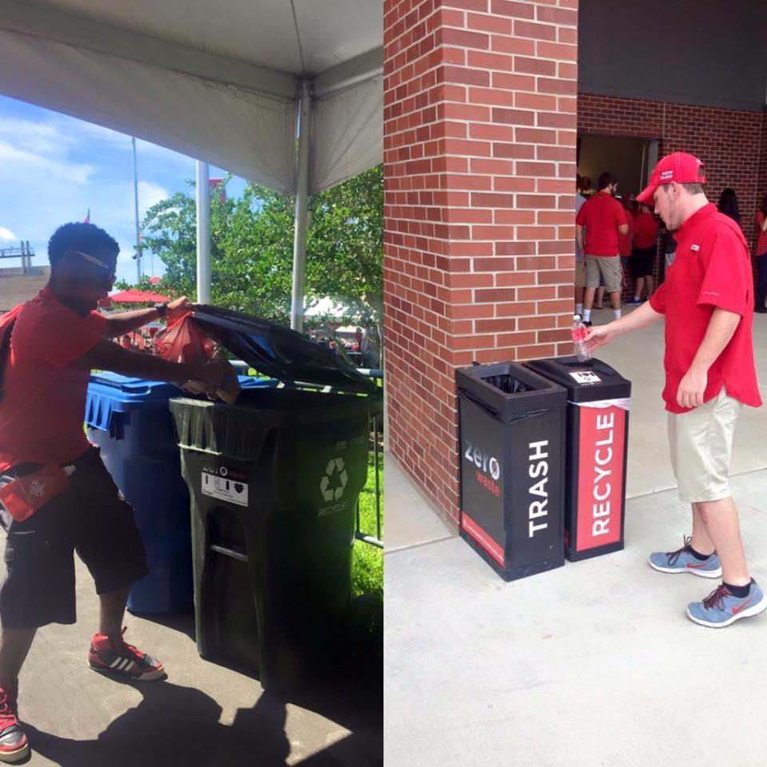
Timeline of UL Recycling and Waste System
Martin Hall and Foster Hall compete in a month long recycling competition.
Recycling is fully implemented for football game days with the help of a Healthy Community Grant,
UL AmeriCorps and Ragin’ Cajun Athletics. Top 10 in Gameday Challenge for Diversion rate.
Recycling is added to offices of all “Zone 4” Buildings.
Fall 2014
Spring 2011
Spring 2013
Recycling is done for the first time during tailgating with self service model.
v
Fall 2013
Student Government Association works with new President, Dr. Joseph Savoie, to pilot recycling paper, plastic bottles, aluminum cans and cardboard in Martin Hall.
Fall 2010
Recycling is added to offices
of all
“Zone 2” Buildings.
Spring 2012
Recycling is added to offices of all
“Zone 5” Buildings.
Fall 2013
Waste and recycling services bid goes out with two options for recycling:
A – Continue with recycling system as is, or
B – Handle recycling system like solid waste system.
$$$$ Recycling System Audit $$$$
Fall 2012
Recycling is added
to offices of all
“Zone 3” Buildings.
July 2014
Jan-April 2014
Fall 2011
Recycling is established
in offices of all
“Zone 1” Buildings.

Slide 13
Timeline of UL Recycling and Waste System
Martin Hall and Foster Hall compete in a month long recycling competition.
Recycling is fully implemented for football game days with the help of a Healthy Community Grant,
UL AmeriCorps and Ragin’ Cajun Athletics. Top 10 in Gameday Challenge for Diversion rate.
Recycling is added to offices of all “Zone 4” Buildings.
Fall 2014
Spring 2011
Spring 2013
Recycling is done for the first time during tailgating with self service model.
v
Fall 2013
Student Government Association works with new President, Dr. Joseph Savoie, to pilot recycling paper, plastic bottles, aluminum cans and cardboard in Martin Hall.
Fall 2010
Recycling is added to offices
of all
“Zone 2” Buildings.
Spring 2012
Recycling is added to offices of all
“Zone 5” Buildings.
October 2014
Fall 2013
Waste and recycling services bid goes out with two options for recycling:
A – Continue with recycling system as is, or
B – Handle recycling system like solid waste system.
$$$$ Recycling System Audit $$$$
Fall 2012
Recycling is added
to offices of all
“Zone 3” Buildings.
July 2014
Jan-April 2014
Fall 2011
Recycling is established
in offices of all
“Zone 1” Buildings.

Slide 14
Timeline of UL Recycling and Waste System
Martin Hall and Foster Hall compete in a month long recycling competition.
Recycling is fully implemented for football game days with the help of a Healthy Community Grant,
UL AmeriCorps and Ragin’ Cajun Athletics. Top 10 in Gameday Challenge for Diversion rate.
Recycling is added to The U and Dupre Library.
We begin “gaming the system.”
Recycling is added to offices of all “Zone 4” Buildings.
Fall 2014
Spring 2011
Spring 2015
Spring 2013
Recycling is done for the first time during tailgating with self service model.
v
Fall 2013
Student Government Association works with new President, Dr. Joseph Savoie, to pilot recycling paper, plastic bottles, aluminum cans and cardboard in Martin Hall.
Fall 2010
Recycling is added to offices
of all
“Zone 2” Buildings.
Spring 2012
Recycling is added to offices of all
“Zone 5” Buildings.
October 2014
Fall 2013
Waste and recycling services bid goes out with two options for recycling:
A – Continue with recycling system as is, or
B – Handle recycling system like solid waste system.
$$$$ Recycling System Audit $$$$
Fall 2012
Recycling is added
to offices of all
“Zone 3” Buildings.
July 2014
Jan-April 2014
Fall 2011
Recycling is established
in offices of all
“Zone 1” Buildings.

Slide 15
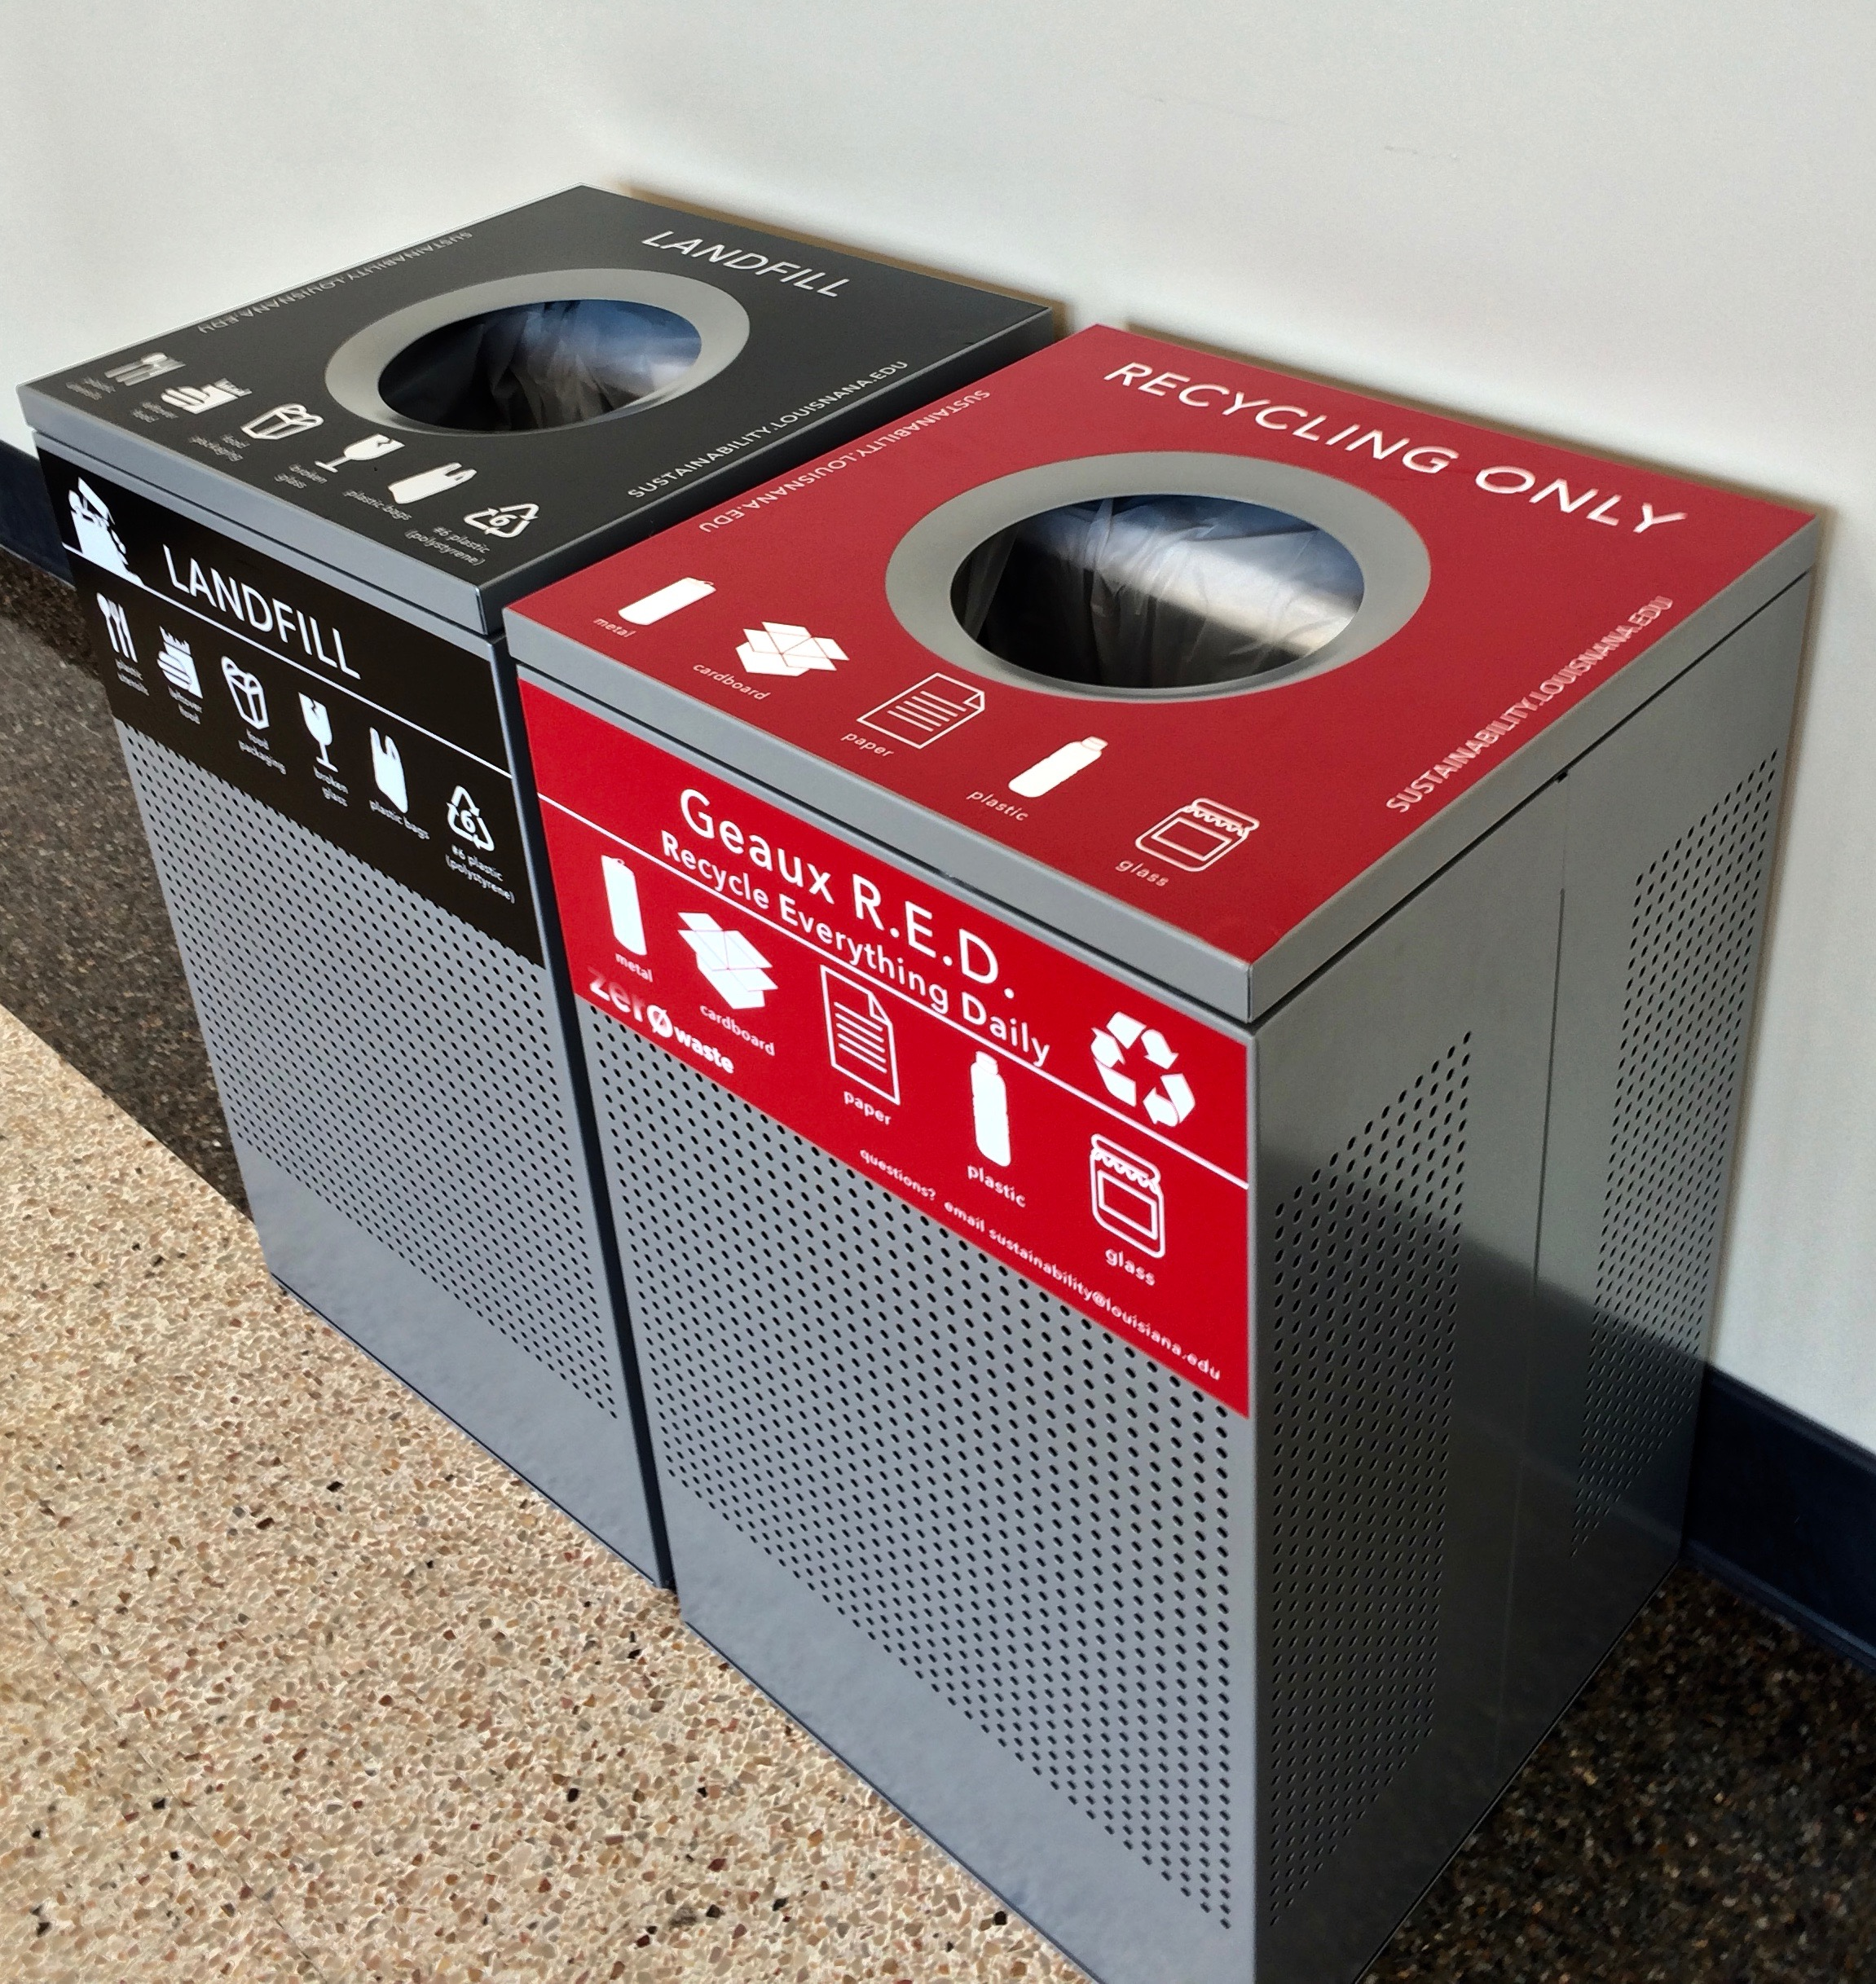
Timeline of UL Recycling and Waste System
Martin Hall and Foster Hall compete in a month long recycling competition.
Recycling is fully implemented for football game days with the help of a Healthy Community Grant,
UL AmeriCorps and Ragin’ Cajun Athletics. Top 10 in Gameday Challenge for Diversion rate.
Recycling is added to The U and Dupre Library.
We begin “gaming the system.”
Recycling is added to offices of all “Zone 4” Buildings.
Fall 2014
Spring 2011
Spring 2015
Spring 2013
Recycling is done for the first time during tailgating with self service model.
v
Fall 2013
Student Government Association works with new President, Dr. Joseph Savoie, to pilot recycling paper, plastic bottles, aluminum cans and cardboard in Martin Hall.
Fall 2010
Recycling is added to offices
of all
“Zone 2” Buildings.
Spring 2012
Recycling is added to offices of all
“Zone 5” Buildings.
October 2014
Fall 2013
Waste and recycling services bid goes out with two options for recycling:
A – Continue with recycling system as is, or
B – Handle recycling system like solid waste system.
$$$$ Recycling System Audit $$$$
Fall 2012
Recycling is added
to offices of all
“Zone 3” Buildings.
July 2014
Recycling is added to 8 academic building lobbies with the help of a Healthy Community Grant and reinvestment of saved costs.
Jan-April 2014
Fall 2015
Fall 2011
Recycling is established
in offices of all
“Zone 1” Buildings.

Slide 16
Timeline of UL Recycling and Waste System
Martin Hall and Foster Hall compete in a month long recycling competition.
Recycling is fully implemented for football game days with the help of a Healthy Community Grant,
UL AmeriCorps and Ragin’ Cajun Athletics. Top 10 in Gameday Challenge for Diversion rate.
Recycling is added to The U and Dupre Library.
We begin “gaming the system.”
Recycling is added to offices of all “Zone 4” Buildings.
Fall 2014
Spring 2011
Spring 2015
Spring 2013
Recycling is done for the first time during tailgating with self service model.
v
Fall 2013
With the addition of of recycling to 9 more academic and administrative buildings lobbies, the University will now have recycling in 50% of our building lobbies.
Student Government Association works with new President, Dr. Joseph Savoie, to pilot recycling paper, plastic bottles, aluminum cans and cardboard in Martin Hall.
Fall 2016
Fall 2010
Recycling is added to offices
of all
“Zone 2” Buildings.
Spring 2012
Recycling is added to offices of all
“Zone 5” Buildings.
October 2014
Fall 2013
Waste and recycling services bid goes out with two options for recycling:
A – Continue with recycling system as is, or
B – Handle recycling system like solid waste system.
$$$$ Recycling System Audit $$$$
Fall 2012
Recycling is added
to offices of all
“Zone 3” Buildings.
July 2014
Recycling is added to 8 academic building lobbies with the help of a Healthy Community Grant and reinvestment of saved costs.
Jan-April 2014
Fall 2015
Fall 2011
Recycling is established
in offices of all
“Zone 1” Buildings.

Slide 18
New Consolidated Solid Waste and Recycling Contract:
Recycling $/cubic yard:
  Previous 95 gallon cart system - $65.22
  New system with dumpsters: $7.71
Per cubic yard, recycling is 11% LESS than solid waste
25% DECREASE in solid waste
925% INCREASE in recycling

Slide 19
Added recycling access to Dupre Library with help of Healthy Community Grant.
New Student Union partially opens with more dining options.
4% INCREASE in solid waste
30% INCREASE in recycling

Slide 20
Significantly reduced solid waste services to right-size the system.
Added recycling access to The U.
More dining options open in The U.
28% DECREASE in solid waste
5% INCREASE in recycling

Slide 21
Added recycling access to 8 academic building lobbies in early 2016 with the help of a 2015 Healthy Community Grant.
Adding recycling access to another 9 academic and administrative buildings next month with the help of a 2016 Healthy Community Grant.
10% DECREASE in solid waste
3% DECREASE in recycling

Slide 22
1,251% INCREASE in recycling

Slide 23
1,251% INCREASE in recycling
48% DECREASE in solid waste

Slide 24
1,251% INCREASE in recycling
48% DECREASE in solid waste
53% DECREASE in monthly costs

Slide 25
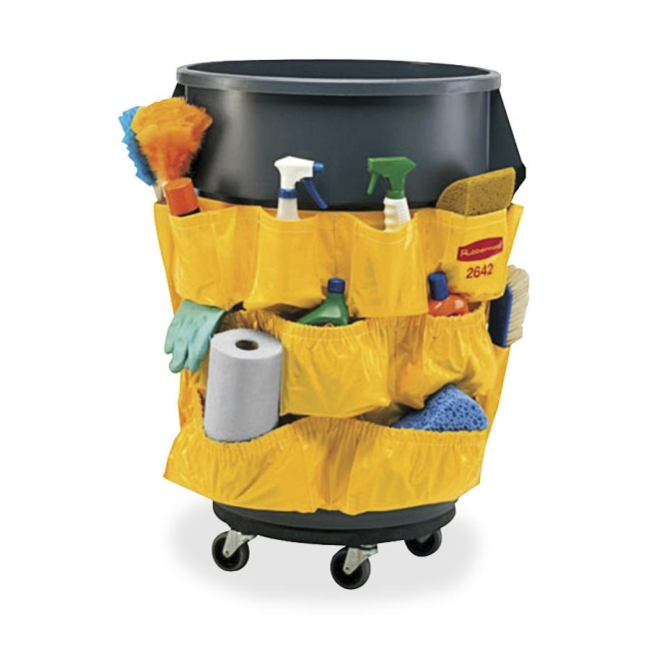
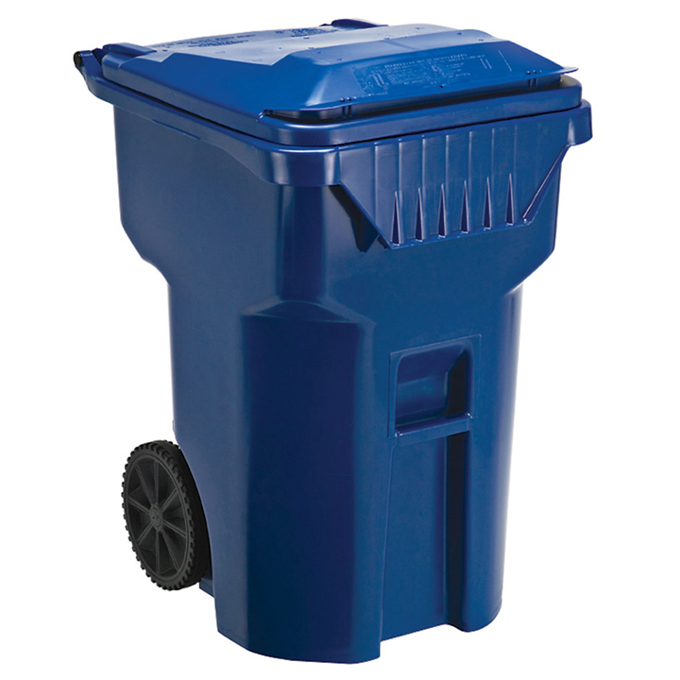
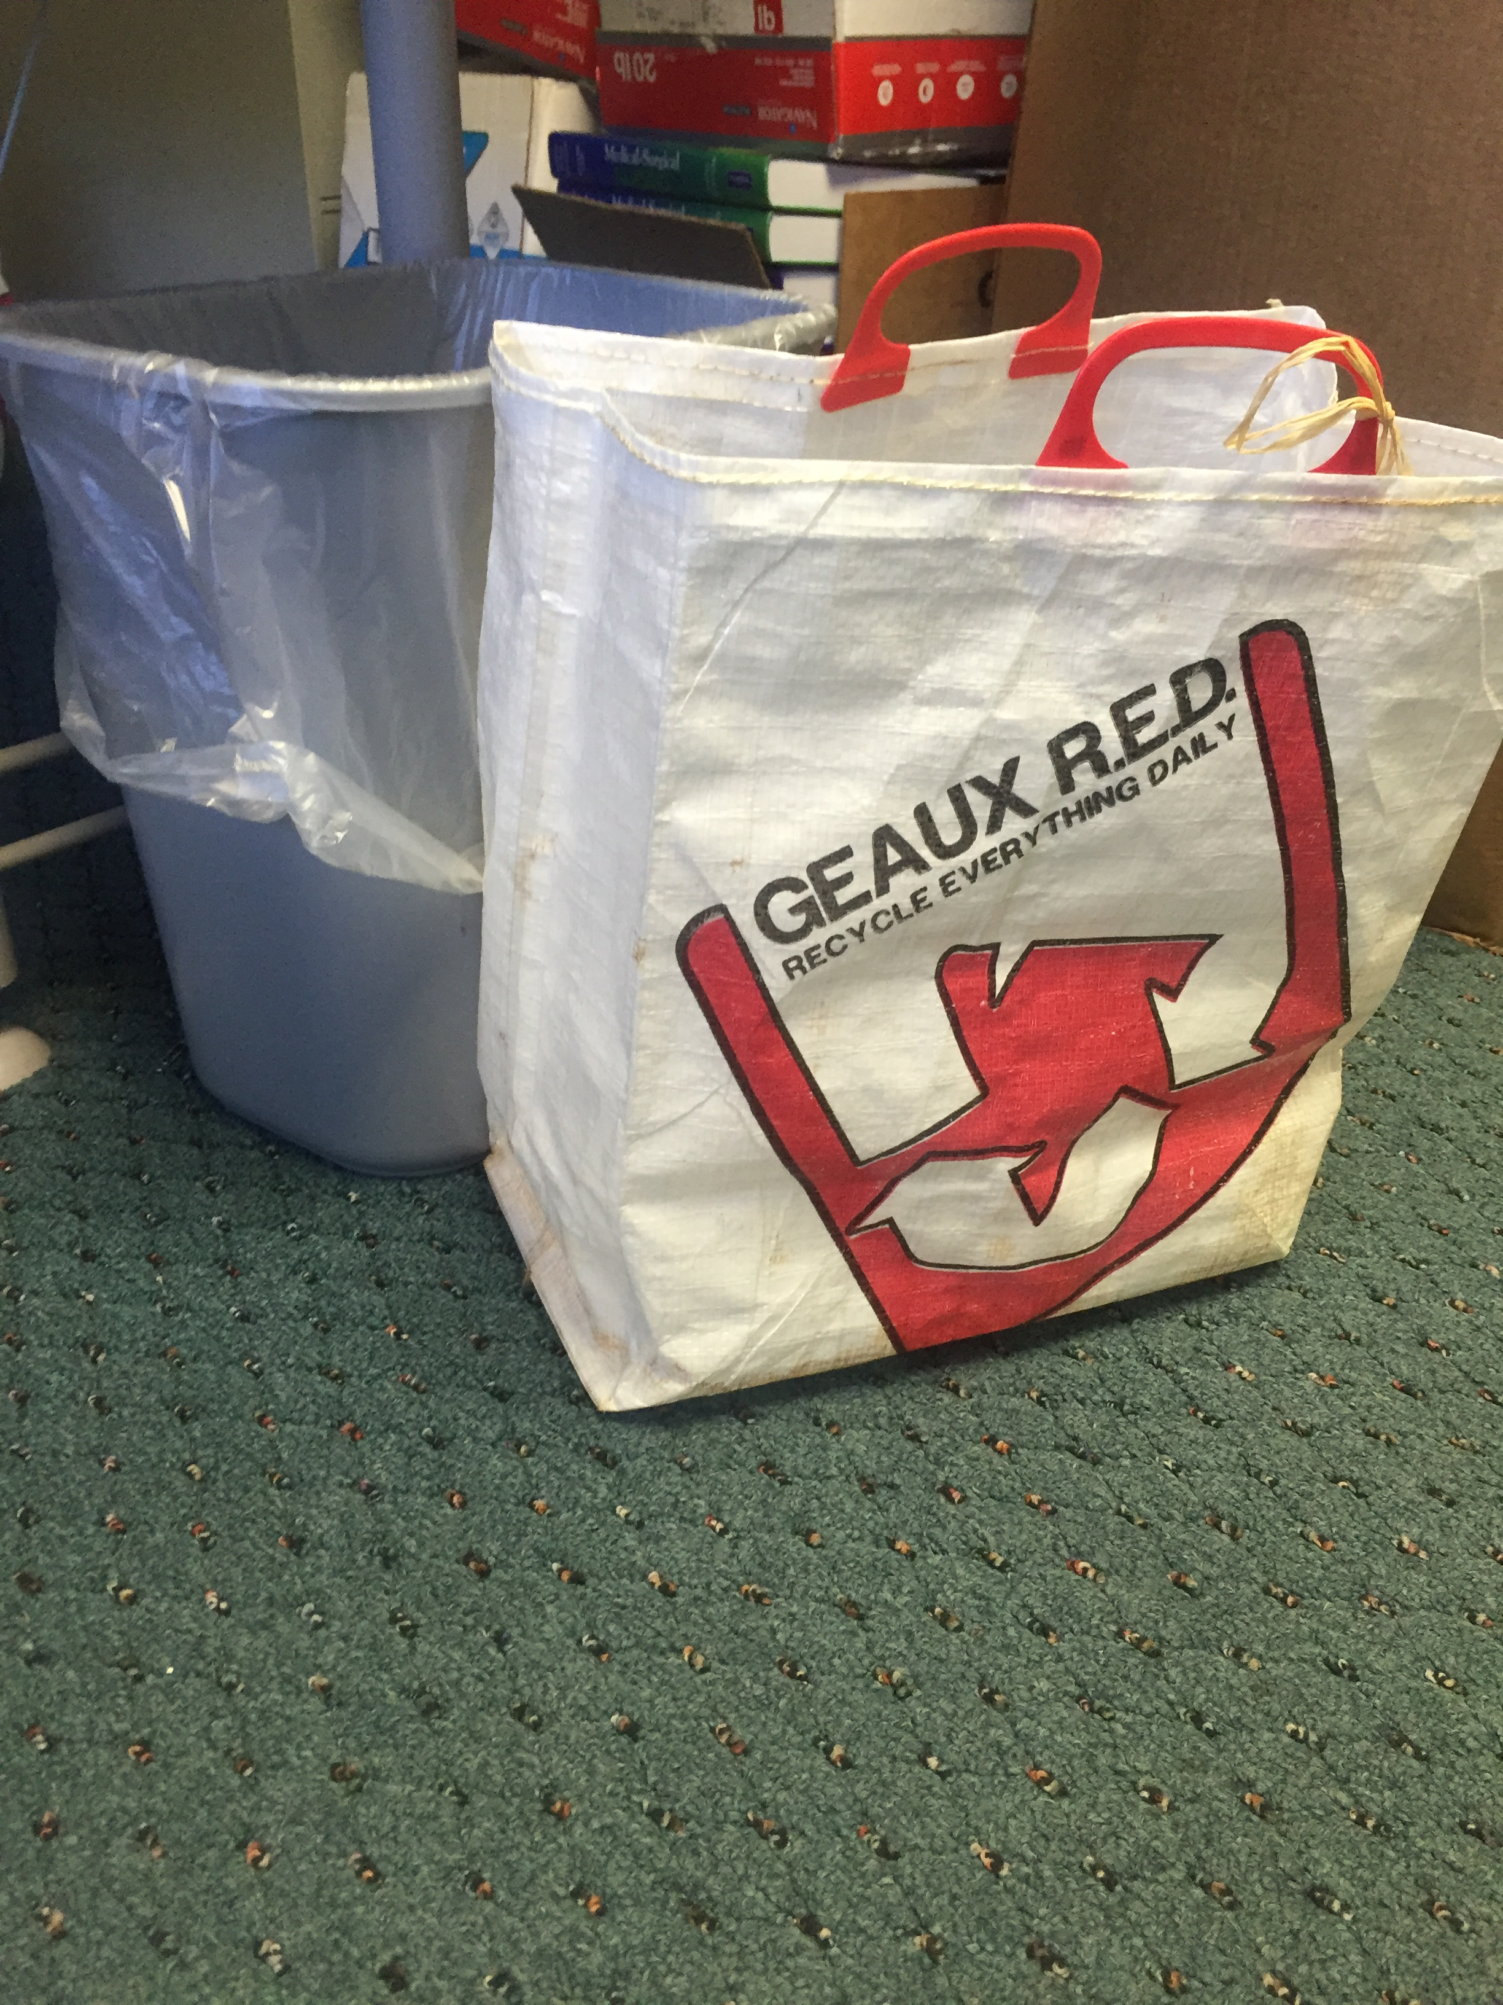
First Recycling System
The System:
DAILY:
Staff recycle white office paper, plastic bottles, and aluminum cans in bags
DAILY:
Custodial staff collect recycled materials, put in clear bag tied to trash cart
DAILY:
Custodial staff empty collected recycled materials in recycling carts located in each building….if they can find it, and its not already full

Slide 26
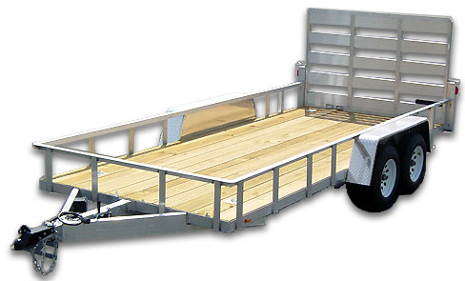
First Recycling System
The System:
Weekly:
Recycling carts are collected by service provider (if they can find them) and exchanged for empty cart
Service provider hauls full carts on a 20’ trailer to site where materials where hand sorted by staff

Slide 27
Recycling and Waste System
System Audit:
Who?
Staff and Faculty
Custodial Managers and staff
Recycling service provider

Slide 28
Recycling and Waste System
System Audit:
Who?
Staff and Faculty
“Custodial staff is mixing materials!
Custodial Managers and staff
Recycling service provider

Slide 29
Recycling and Waste System
System Audit:
Who?
Staff and Faculty
“Custodial staff is mixing materials!
“The blue containers are in the way, so I moved it to a stairwell…or closet..or…
Custodial Managers and staff
Recycling service provider

Slide 30
Recycling and Waste System
System Audit:
Custodial Managers and staff
“We keep the recycled materials separate in another bag and put it in the recycle bins…on Monday, maybe Tuesday. Then it is full, so we trash it.”
Who?
Staff and Faculty
“Custodial staff is mixing materials!
“The blue containers are in the way, so I moved it to a stairwell…or closet..or…
Recycling service provider

Slide 31
Recycling and Waste System
System Audit:
Custodial Managers and staff
“We keep the recycled materials separate in another bag and put it in the recycle bins…on Monday, maybe Tuesday. Then it is full, so we trash it.”
“Sometimes, we can’t find the recycling bins…so we trash it”
Who?
Staff and Faculty
“Custodial staff is mixing materials!
“The blue containers are in the way, so I moved it to a stairwell…or closet..or…
Recycling service provider

Slide 32
Recycling and Waste System
System Audit:
Custodial Managers and staff
“We keep the recycled materials separate in another bag and put it in the recycle bins…on Monday, maybe Tuesday. Then it is full, so we trash it.”
“Sometimes, we can’t find the recycling bins…so we trash it”
Who?
Staff and Faculty
“Custodial staff is mixing materials!
“The blue containers are in the way, so I moved it to a stairwell…or closet..or…
Recycling service provider
“We couldn’t find the recycling bin. So we’ll pick it up next week.”

Slide 33
Recycling and Waste System
System Audit:
Custodial Managers and staff
“We keep the recycled materials separate in another bag and put it in the recycle bins…on Monday, maybe Tuesday. Then it is full, so we trash it.”
“Sometimes, we can’t find the recycling bins…so we trash it”
Who?
Staff and Faculty
“Custodial staff is mixing materials!
“The recycling containers are in the way, so I moved it to a stairwell…or closet..or…
Recycling service provider
“We couldn’t find the recycling bin. So we’ll pick it up next week.”
“The bins had trash in it, so we didn’t pick it. Please, have your staff dump it in the trash and we will be back next week.”

Slide 34
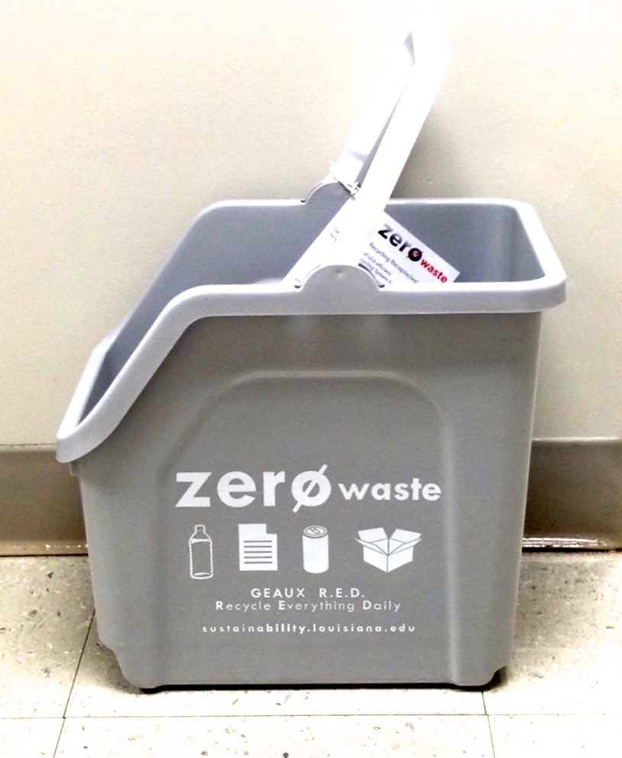
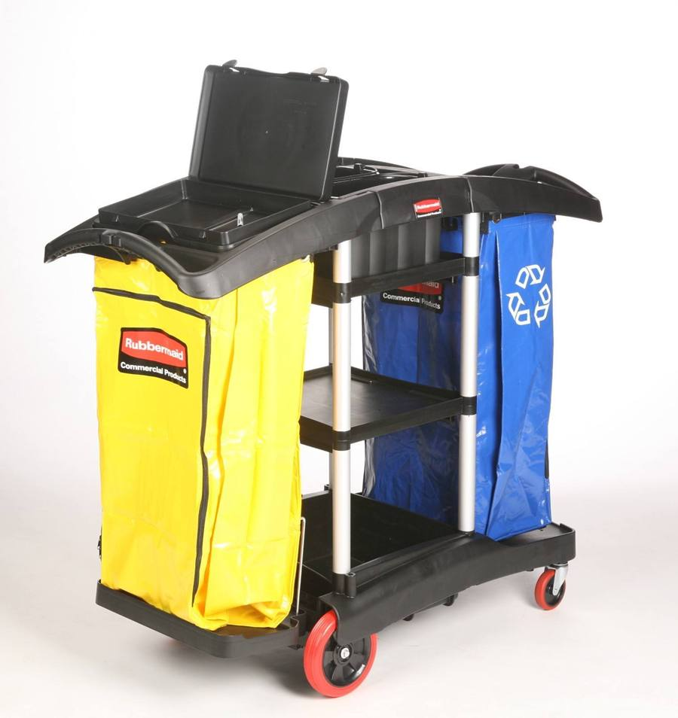
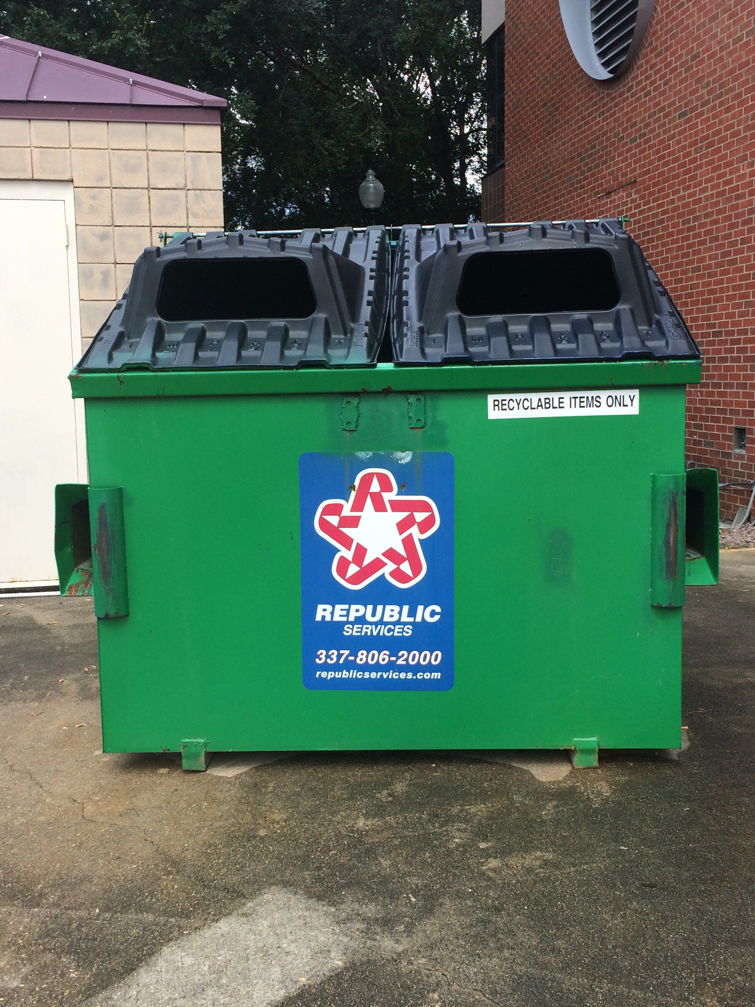
Second Generation Recycling System
The Equipment:
Zero Waste Bins:
Can be easily cleaned
$4.57/unit
Custom Graphics
Busch Systems “Multi-recycler”
Dual Stream Custodial Cart:
Helped change perceptions
More likely that recycling and waste are kept separate – FROM THE DESK TO THE DUMPSTER
Rubbermaid
Recycling Dumpsters:
Greater volume
More control over
Moved the final campus destination outdoors – less contamination, easily accessed by service provider

Slide 35
Second Generation Recycling System
The System:
INDOORS
OUTDOORS
DAILY:
Staff recycle all paper, plastics 1-7 (not #6 foam), aluminum cans, and cardboard in bins
DAILY:
Custodial staff collect recycled materials and trash, and keep it separate
DAILY:
Custodial staff dump recycled materials in recycling bins outside of buildings that are co-located with trash dumpsters.

Slide 36
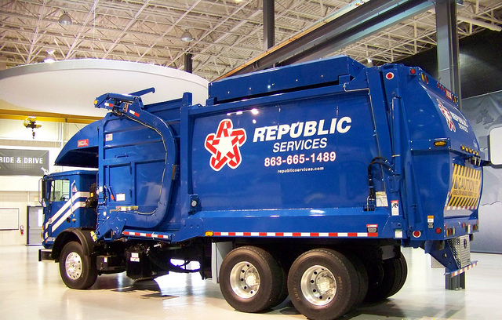
Second Generation Recycling System
The System:
OUTDOORS
SCHEDULE VARIES:
Service provider picks We can add or decrease pickups on a weekly basis.
Custodial staff collect recycled materials and trash, and keep it separate

Slide 37

What makes an effective waste and recycling management system cost effective?

Slide 38
What makes an effective waste and recycling management system cost effective?
#1: Division, not addition

Slide 39
What makes an effective waste and recycling management system cost effective?
#1: Division, not addition

Slide 40
What makes an effective waste and recycling management system cost effective?
#1: Division, not addition

Slide 41
What makes an effective waste and recycling management system cost effective?
#1: Division, not addition
#2: Control of the schedule, and the size and quantity of containers
Monday
Tuesday
Wednesday
Thursday
Friday

Slide 42
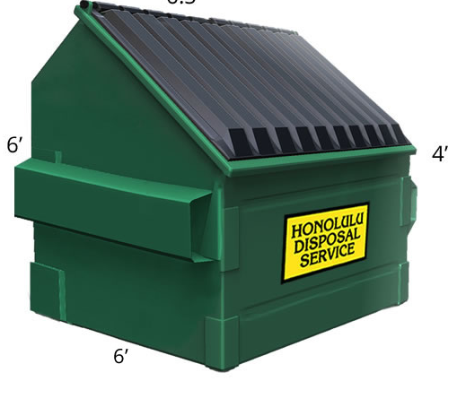
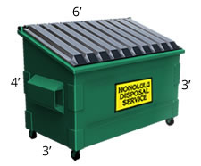
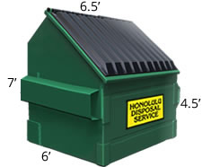
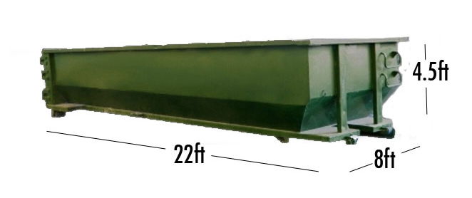
What makes an effective waste and recycling management system cost effective?
#1: Division, not addition
#2: Control of the schedule, and the size and quantity of containers
Monday
Tuesday
Wednesday
Thursday
Friday

Slide 43
What makes an effective waste and recycling management system cost effective?
#1: Division, not addition
#2: Control of the schedule, and the size and quantity of containers
#3: Manage the system…by the day
Monday
Tuesday
Wednesday
Thursday
Friday

Slide 44
What makes an effective waste and recycling management system cost effective?
#1: Division, not addition
#2: Control of the schedule, and the size and quantity of containers
#3: Manage the system…by the week
1st Week of the month
2st Week of the month
^{3rd} Week of the month
4th Week of the month

Slide 45
What makes an effective waste and recycling management system cost effective?
#1: Division, not addition
#2: Control of the schedule, and the size and quantity of containers
#3: Manage the system…by the month
April
June
September
December

Slide 46
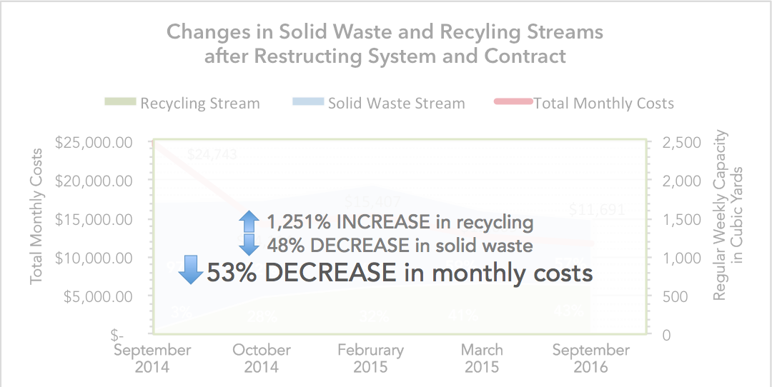

What makes an effective waste and recycling management system cost effective?
#1: Division, not addition
#2: Control of the schedule, and the size and quantity of containers
#3: Manage the system
#4: Reasonable and obvious access to recycling bins

