Slide 1

Reduce, Reuse and Recycling
Keep Louisiana Beautiful State Meeting
September 28, 2016

Slide 2
Objectives
Hear about your challenges
Share:
  education and behavior change strategies
  Reduce and reuse ideas
Identify FREE tools and resources to support improving recycling

Slide 3
Strategic Impact Goals (2025)
End
Littering
Improve Recycling
Beautify Communities
END LITTERING IN AMERICA
  Reduce litter by 35% in Keep America Beautiful affiliate service areas
IMPROVE RECYCLING IN AMERICA
  Improve recycling attitudes and behavior by 20% and quality by 15%;
  Provide 5 million individuals with on the go recycling
BEAUTIFY AMERICA’S COMMUNITIES
  Improve, restore and maintain 1 million public spaces

Slide 4
Improve Recycling
Educate, motivate, activate individuals to recycle
Individuals & Consumers
Workplace
College
K-12
America Recycles Day
“I Want To Be Recycled” PSA
Recycling on the Go
Recycling@Work
Recycle
Mania
Recycle-Bowl

Slide 5
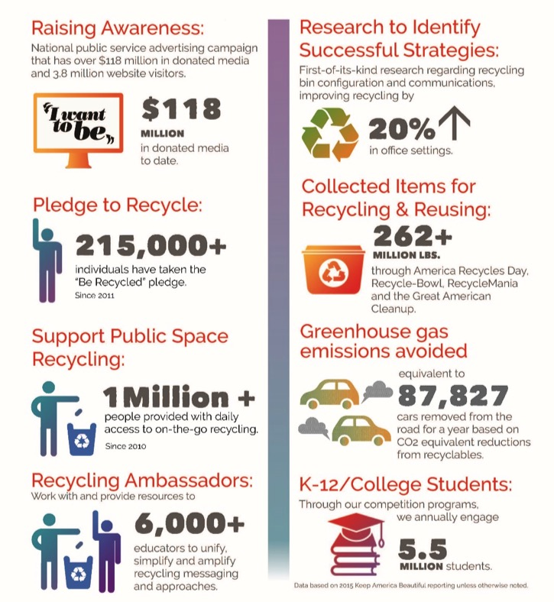
Improve Recycling:
2015 Actions & Impact

Slide 6
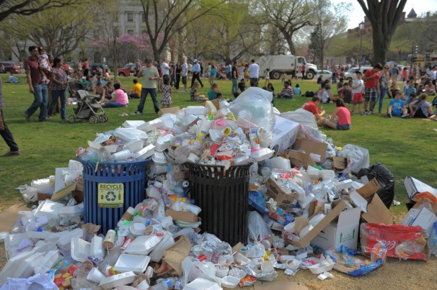
Do people care about recycling?
Notes:
Cherry Blossom Festival – photo taken from Washington Post article – embarassing!

Slide 7
KAB Behavior Change System:
5 Step Management Process
1
Get the Facts
5 Step
Management Process
5
Provide Positive
Reinforcement
2
Involve the People
4
3
Focus on Results
Develop a Plan
* Part of KAB Behavior System
Notes:
1. Get the Facts
Research the needs for your community. Interview field professionals and interested stakeholders, conduct surveys, focus groups, literature reviews, and gather data through third-party research. Then assemble all the data to help target an approach to individual and community change.
2. Involve the People
Identify the people who have the most influence over the identified target areas. Let them know what you would like to do. Determine how it can match their interests, and capitalize on that to develop the program. Let them involve people they know or with whom they work. The volunteer network will spread. Delegation is the key.
3. Develop a Plan
Once the leadership and other key individuals agree, develop a plan of action. The plan should address the who, what, where, when and why. Identify applicable tools, contacts, and resources, including those provided by KAB.
4. Focus on Results
The goal is to achieve measurable community improvement results. Focus on results that show a change in behavior such less litter, a reduction in graffiti vandalism, increased recycling, etc. Results may also be shown through number of volunteers, trees planted, or bags of litter collected. Identify and focus on all results.
5. Provide Positive Reinforcement
To motivate individuals to sustain environmental and quality-of-life changes in the community, provide regular feedback. Communicate specific and targeted results to neighborhoods, the business community, and residents. Involve the media, when appropriate, in sharing positive results more broadly. Give all volunteers and supporters of your organization appropriate recognition. People must feel positive about their efforts if they are to sustain their interest.

Slide 8


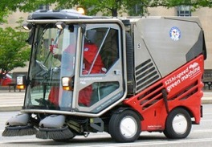

Behavior Change System:
4 Behavior Strategies
Written Expectations –Ordinances/ Policies
Consequences- Incentives/Enforcement
Tools and Technology
Education
* Part of KAB Behavior System
Notes:
KAB has identified that by evaluating, changing or improving these strategies (pressure points), behavior change will occur. How does the Keep America Beautiful System work? Through an understanding of the normative systems in our community that unwittingly encourage littering behavior and by identifying the pressure points at which it can be changed.
Written Expectations
What are our written expectations for behavior? Examples: Guidelines, Memorandum of Understanding, Contracts, Policies, Ordinances
Consequences
What are the consequences, positive or negative, for behaviors? Are incentives provided? Is there an enforcement – positive or negative? Examples: Compliance education, public awareness of the laws and expectations; Education of officials and staff; Social norms and social diffusion
Tools and Technology
What are the resources and technologies needed to support behavior change? Examples Technology (equipment or tools) and structural change (physical environment)
Educational Strategies
What methods will we use for educating others about this change and how they can support it? Social Marketing concepts including: Commitment, Prompts, Communication Actions include: School programs, after school and other youth programs, training seminars, media campaigns, social marketing, civic clubs, business organizations, government agencies
All may have Economic Impacts
What economic impacts will result with and without this behavior change? Examples: Cost of litter on maintenance budgets, property values, tree benefits, retail activity, tourism values, costs of damage to ecosystem and storm system infrastructure; value of waste materials to be recycled; recycling jobs, energy saved; Group or individual incentives

Slide 9
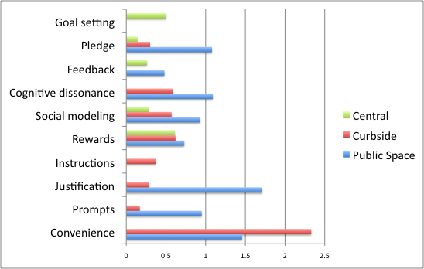
What Works: Different Types of Recycling
Note: Meta analysis of recycling studies, combined across three types of programs. N=41 public, N=52 curbside, N=18 central collection. Osbaldiston & Schott (2012)

Slide 10
Ease of Recycling by Location
Recyclers find it easiest to recycle in their own residence.
Base: Recyclers, n=793
Q: For each of the following locations, please tell me how difficult it is to recycle there, using a scale from 0 to 10, where 0 is not difficult at all and 10 is extremely difficult

Slide 11
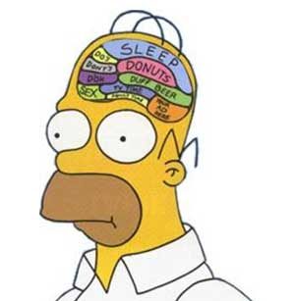
Getting People To Recycle
Behavior Change Strategies:
  Commitment
  Social Norming
  Removing Barriers
  Communication
  The Homer Principle:
    Recycling isn’t focus of their attention
    All bins are “waste” bins at first glance
Notes:
Homer embodies the 70%
Research shows - Not passionate about recycling, but willing to do.
Primary Goal: not to make them care / be fluent. Goal is to Remove barriers
Less important that they care – instead goal to make it a habit
Barriers:
Lack of access
confusion
Homer principle - success by understanding their needs as much as making them understand yours
Not focus of attention
All bins are waste bins
No bubble for recycling in homer’s brain.
Program managers must design bins to anticipate this

Slide 12
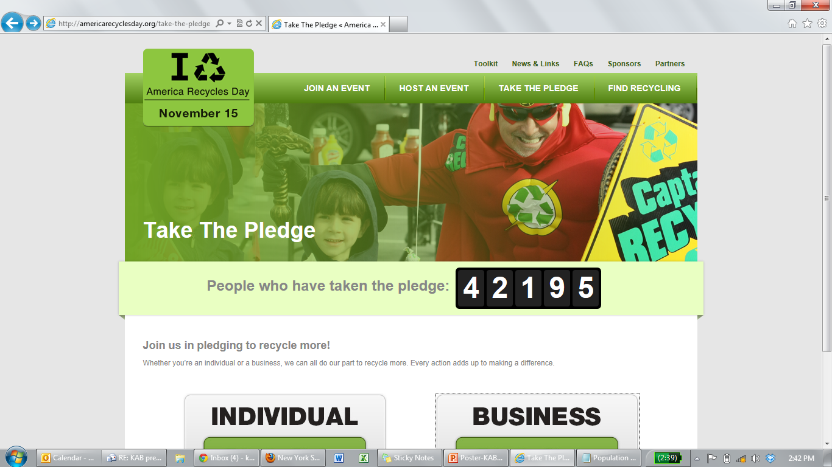
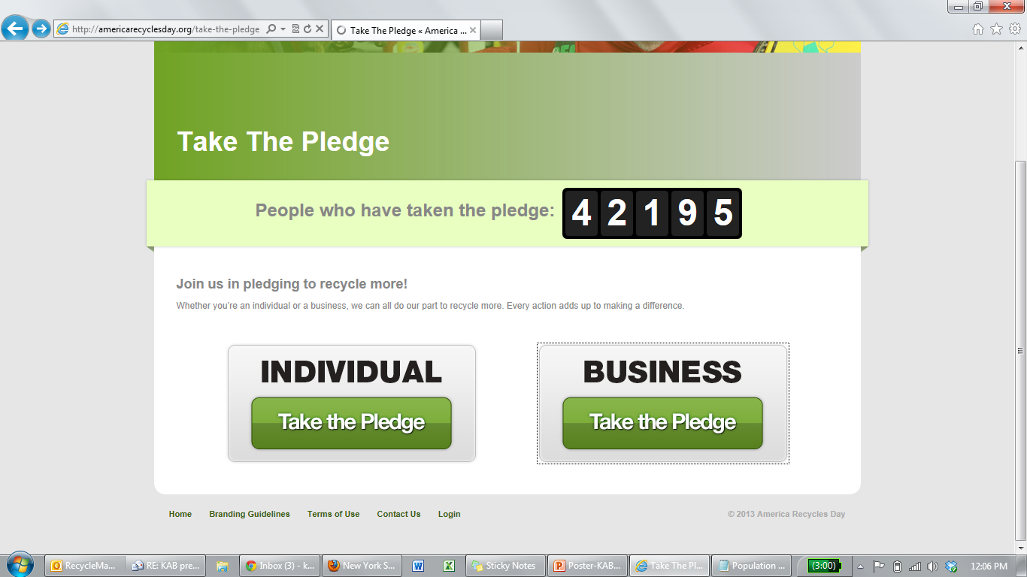
Commitment Research and Strategies
Literature Research Recommendations:
Strategies:
Norm Messaging
Commitment
Communication
Notes:
Research: A literature review was conducted by Wes Schultz, a social psychology professor with the University of CA, San Marcos. He recommended: pledge language be specific, build a private pledge that can be made visible to others and which medium to use
Strategies:
Norm Messaging
Commitment
Communication

Slide 13
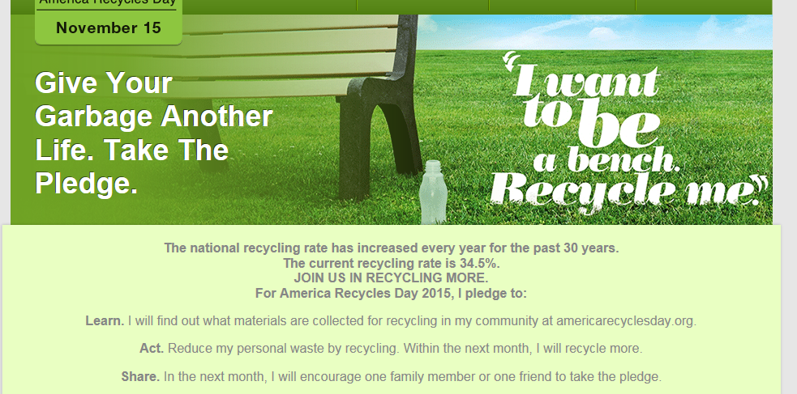
America Recycles Day Commitment
  Verbal or written agreements
  Short and long term change
  Be positive and specific
Notes:
Commitment is using verbal or written agreements to encourage people to adopt a behavior. Research has shown that commitment result in both short-term change, such as immediately changing one’s light bulbs to CFLs, and long-term change, such as committing to bike to work once a week for a year.
For example, the America Recycles Day pledge asks pledge takers to commit to learning more about what they can recycle, and then using that knowledge to increase their personal level of recycling. Recent survey research suggests that people who have taken the pledge perceive that since the pledge, they have increased their recycling knowledge and behavior.

Slide 14
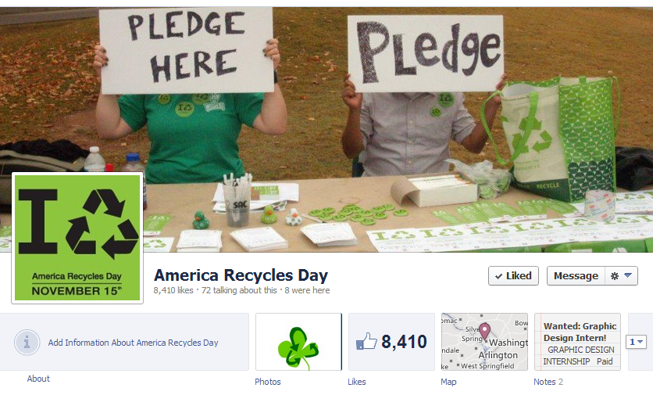
America Recycles Day Commitment Impact
Response rate: 10%
Report knowing more: 32%
Report more committed to act: 34%
Encourage others: 32%
Pledge Impact (survey conducted 2013)
Notes:
*NOTE-CONDENSED RESULT SLIDE. USE EITHER THIS OR SOME NUMBER OF THE NEXT 4 SLIDES—BASICALLY SAME INFO ON BOTH*
Most of you probably know ARD. Raise your hand if you conduct an ARD event.
We promote recycling education and collection events in the workplace, at schools, local government offices, and other community locations
Performance Metrics: (2012)
Presidential proclamation that sparked national mentions on two late-night talk shows
Participants increased to 2.1+MM
95,000 pledges taken (45,000 on-line and 50,000 at recycling events)
Impact: (2013)
Self report survey data following a retrospective pretest model, meaning that we sent out a survey after they took the pledge, and asked them to compare their knowledge and behavior NOW, post pledge, to before they took the pledge, to see if they perceived changes. We got a 10% response rate, which is great for survey research on an audience of this size, and used questions that had been previously tested by academic researchers.
32% of respondents reported knowing more about recycling after taking the pledge than they did before
34% of respondents reported being more committed to recycling after taking the pledge than they did before
32% of respondents reported encouraging others to recycle more after taking the pledge than they did before, even though the 2012 pledge did not specifically ask them to do so
Research suggests that having a social norm around recycling behavior is very important, so we’re expanding the pledge this year by asking pledgees to share the pledge with others to harness the fact that this audience is already choosing to spread the recycling message without being asked.
Survey details:
Knowledge is measured by 3 questions:
I know what shouldn’t go in a recycling bin.
I know which of the products I frequently use are recyclable.
I know what materials can be recycled in my community.
Commitment to Behave is measured by 3 questions:
When I have a recyclable product, I always recycle it.
If no recycling bin is present, I will carry my recyclables until I find one.
I am committed to recycling in my daily life.
Spreading Recycle norm is measured by 1 question:
I encourage people around me to recycle.
Perceiving norm is measured by 1 question:
My neighbors and friends expect me to recycle

Slide 15
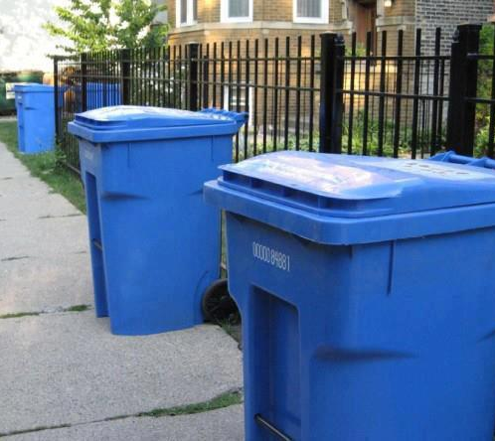
Conclusions
Behavioral strategies can make a difference
Proven through research, testing and evaluation
Key Approaches:
  Convenience
  Communication
    Be positive
    Keep it simple
  Consistency

Slide 16
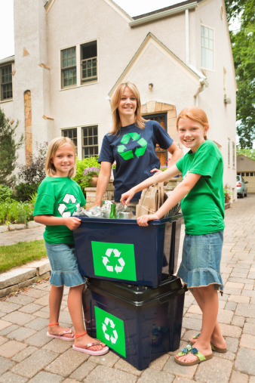

National Recycling PSA Campaign
Increase recycling participation by creating strong passion and reason to believe in recycling

Slide 17
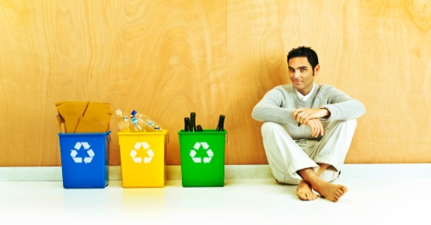
Campaign Goals
Increase recycling participation
Educate and motivate people to recycle more
Transform recycling into a daily social norm
Provide tools to inform people how & where to make recycling happen
Call to Action
Give your garbage another life.
Notes:
Our goals are straightforward…yet riddled with complexities

Slide 18
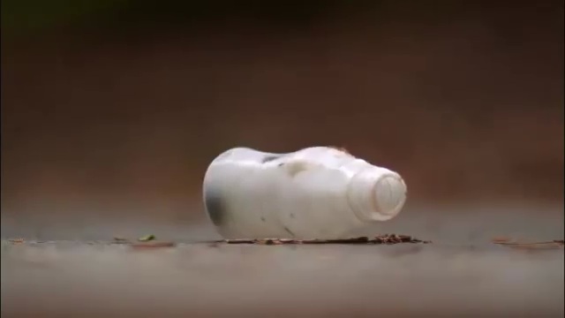
PSA: Journey

Slide 19
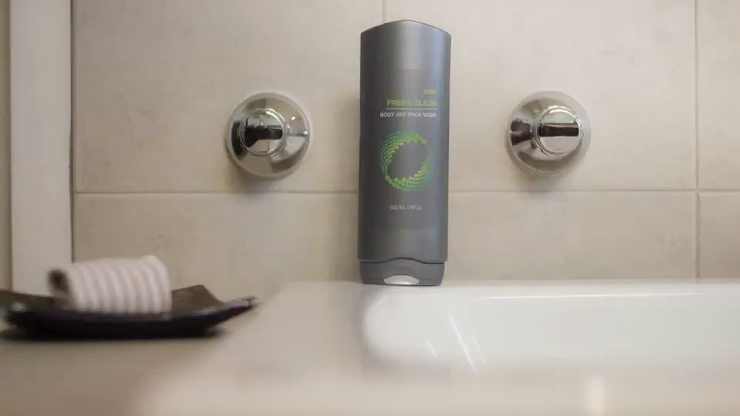
Superhero :30
Notes:
Superhero: https://www.youtube.com/watch?v=1ZVsmrXDJ-I

Slide 20
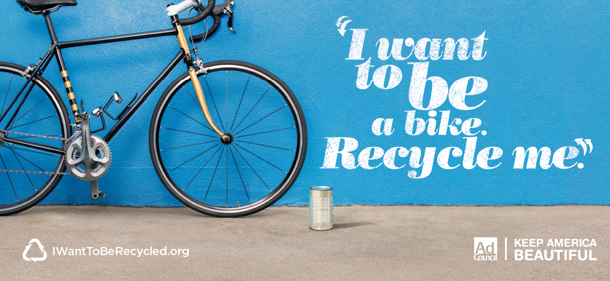

Campaign Results Overview
$125M
Total campaign
donated media
Exposure
38%
Have seen/heard the campaign
Awareness
3.8M+
Visitors to Website
Engagement
Notes:
AC

Slide 21

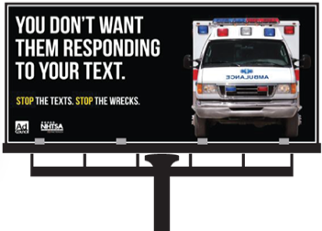

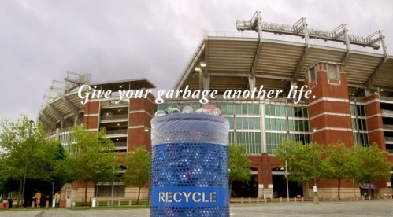
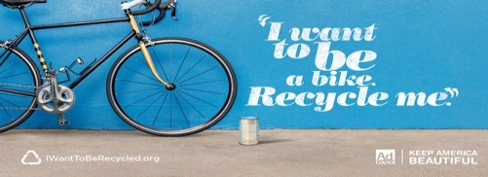
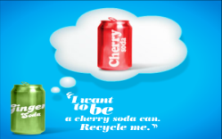
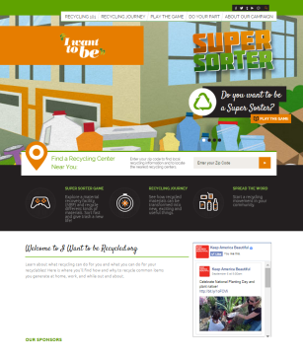
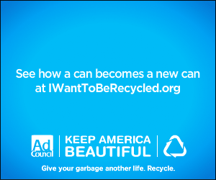
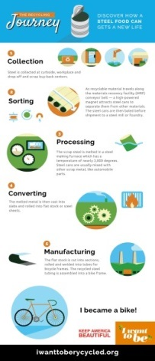
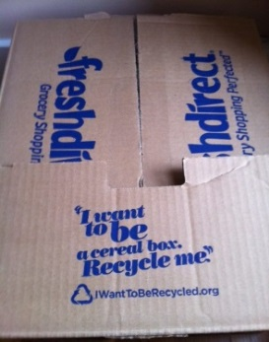
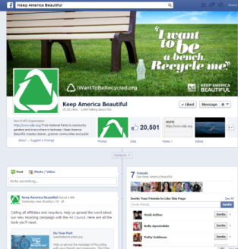
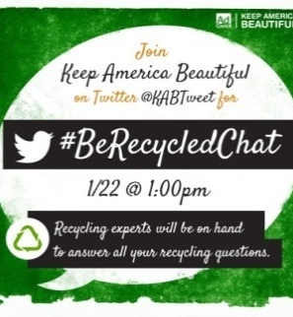
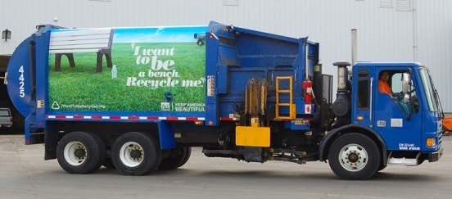

Integrated Campaign
Mobile ◦ Social ◦ Outdoor ◦ Partnership ◦ TV ◦ Online ◦ Radio
Notes:
We hope you enjoyed the video and look forward to your feedback at the end. This has been an integrated campaign from the beginning. We have seen cities wrap their trucks in the campaign creative; grocery stores using the slogan on their packaging, and the social and digital presence of this campaign is truly robust – you will hear more about that from Christina in a few minutes.
I encourage you to visit I Want To Be Recycled.org to take advantage of a number of tools we have available, from flyers to web banners to an interactive game about recycling.
1.8 M unique visits to IWantToBeRecycled.org since launch

Slide 22
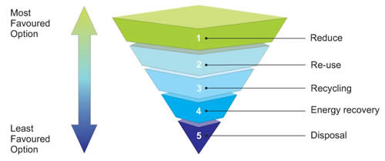
WASTE HIERARCHY
Notes:
Address Integrated Waste Management – Recycling and Trash pick up

Slide 23
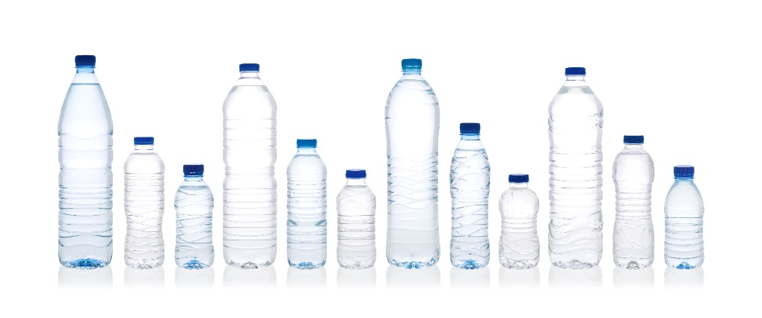
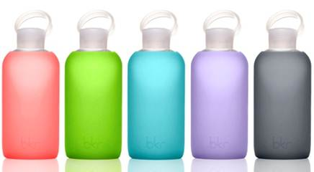
Water Bottles
Americans throw away 35 billion plastic water bottles every year
The average American uses 167 disposable water bottles, but only recycles 38 of them
More than 75% of plastic water bottles are never recycled, they’re simply thrown away
How can you reduce the use of plastic water bottles?
  Use a reusable bottle
Notes:
SUNY Oswego Case Study:
- Tap In 2016 during Recycle Mania.
- Distributed over 2,500 reusable water bottles and over 1,500 reuse­tracking stickers in a program aimed to give students the opportunity avoid disposable single ­use water bottles and track their impact.
- Upon completion, finished Recyclemania campaign with 22,000-­23,000 plastic water bottles diverted from the waste stream.
http://curc3r.org/wp-content/uploads/2016/04/SUNY-Oswego-Tap-In-2016.pdf
http://www.bottlesupglass.com/wp-content/uploads/2011/08/Facts-About-Plastic-Bottles-and-Bottled-Water.pdf
http://greenliving.lovetoknow.com/Reusing_Plastic_Water_Bottles

Slide 24
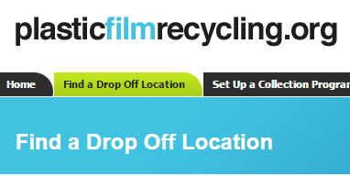

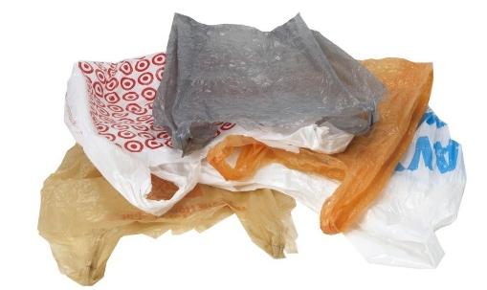
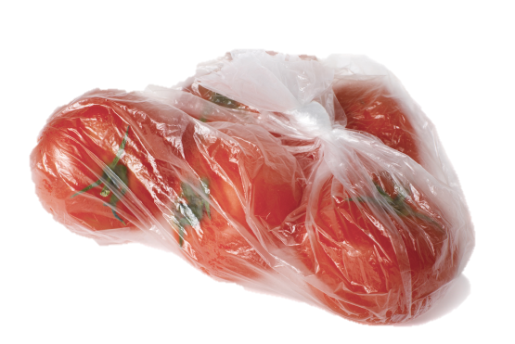
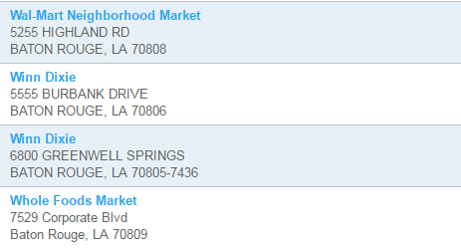
Plastic Bags and Wrap
100 billion plastic bags used each year in the U.S.
Reduce – by reusing a bag
Recycle single use bags and wrap
Notes:
http://www.bagtheban.com/
https://www.plasticsindustry.org/files/about/fbf/myths+facts_grocerybags.pdflearn-the-facts/recycling

Slide 25
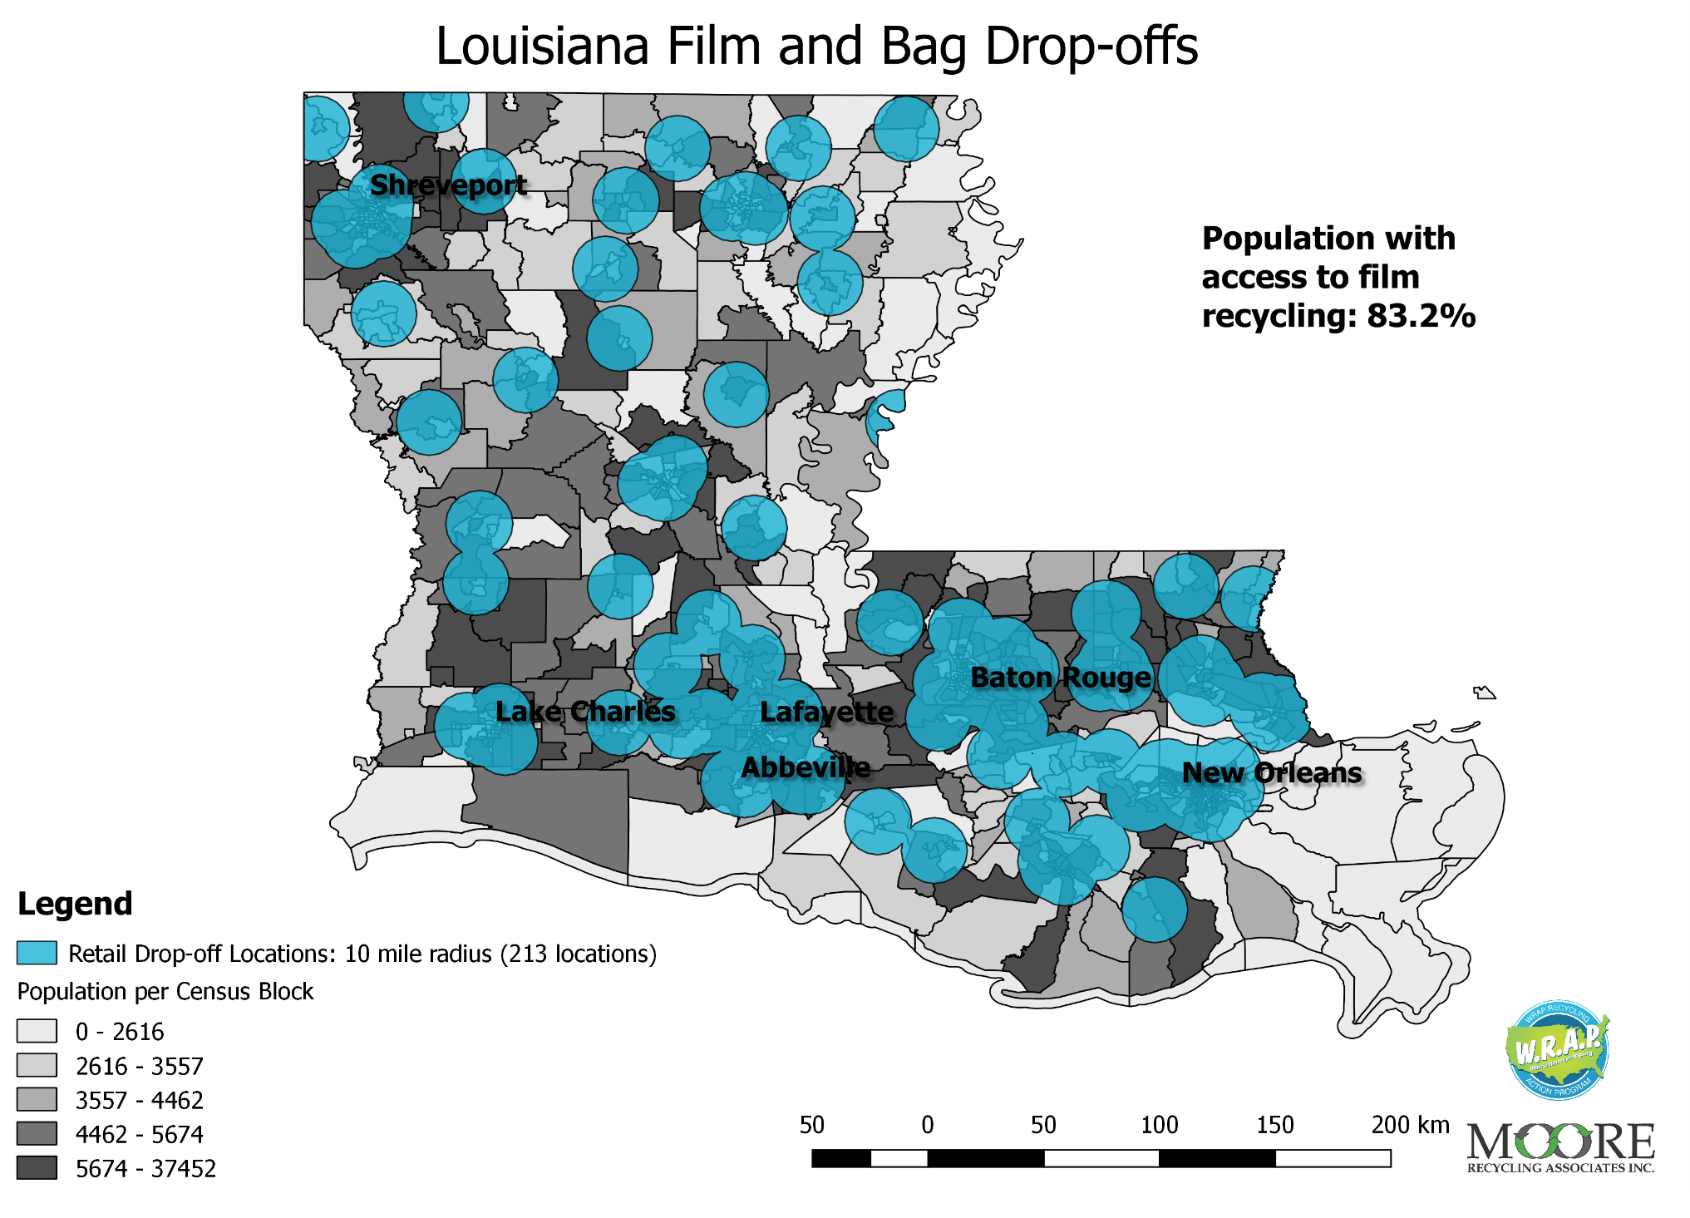
Louisiana Bag Drop off Locations

Slide 26

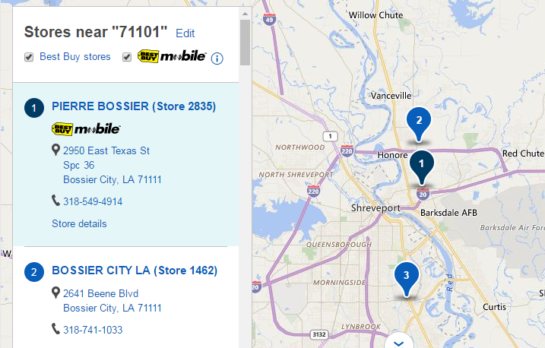
Electronics
The United States produces 9.4 million tons of e-waste annually, more than any other country.
Recycling one million laptops saves the energy equivalent to the electricity used by 3,657 U.S. homes in a year
How can you reduce your electronc waste?
  Many major retailers will take e-waste for recycling, including Best Buy, Staples, Target, Best Buy, Walmart and Verizon.
Notes:
http://earth911.com/eco-tech/20-e-waste-facts/

Slide 27
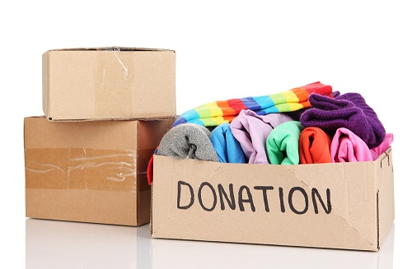

Textiles
The average person throws away 70 pounds of clothing per year. That adds up to 3.8 billion pounds of unnecessary waste per year.
  Currently, 15% gets donated or recycled, 85% goes directly to landfills.
How can you reuse your old clothes?
  Resell at secondhand clothing stores
  Donate
  Turn into a cleaning cloth
Notes:
http://www.smartasn.org/educators-kids/textile_recycling_fact_sheet.pdf

Slide 28
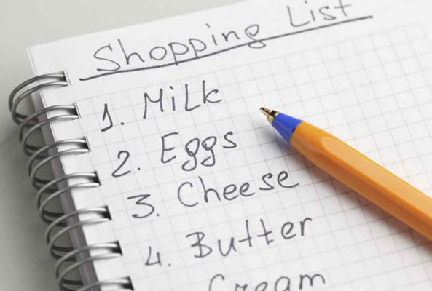
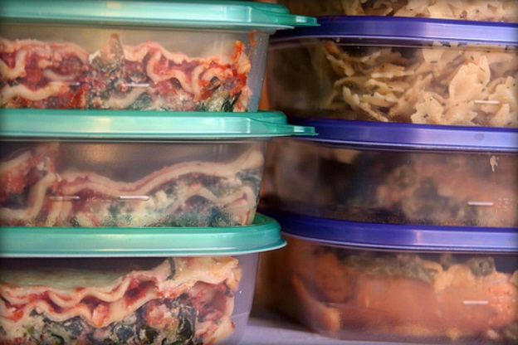
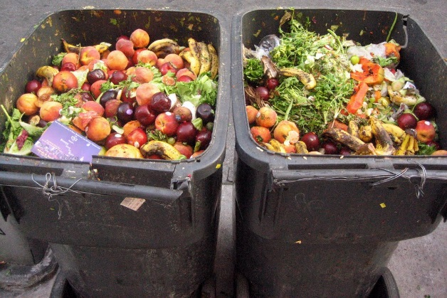
Food Waste
Americans throw away 40% of the food supply annual
The average American family of four throws away $2,275 each year in food alone
How can you reduce food waste?
  Make notes of what is in your refrigerator
  Freeze foods you know you will not be able to eat soon
  Check to see what you have in the refrigerator and cabinets before shopping
Notes:
NERC

Slide 29


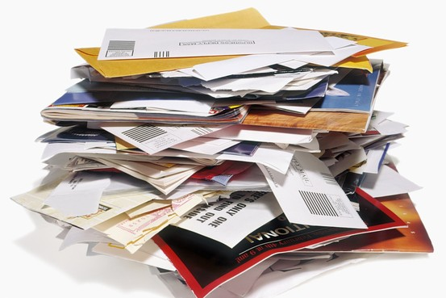

Unwanted Mail
Americans receive nearly 90 billion pieces of advertising mail every year.
How can reduce unwanted mail?
  Opt out mailing lists: CatalogChoice.org and DMAchoice.org
  Opt out for phone book: https://www.yellowpagesoptout.com/
  Choose to receive statements/bills electronically

Slide 30
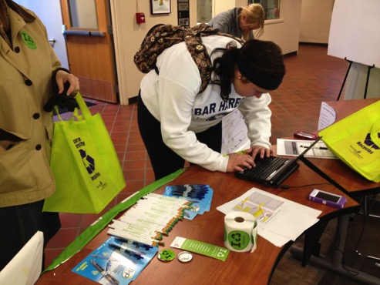
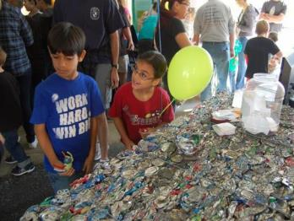
America Recycles (November 15 and beyond)
The only nationally-recognized day dedicated to promoting and celebrating recycling in the United States.
An opportunity to make recycling bigger and better 365 days a year.
A cause to encourage your friends, neighbors, classmates and colleagues to recycle and inform them on the right things to recycle.
Notes:
Park bench giveaway for 5 random pledge takers
TIP OF THE MONTH: – email, text communications to 50,000+ pledge makers – sponsors recognition

Slide 31
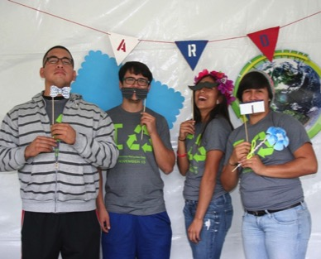
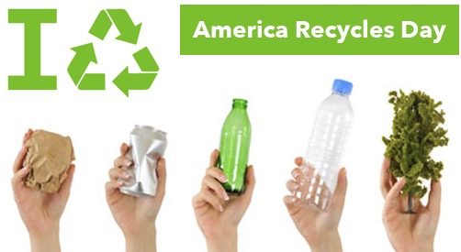
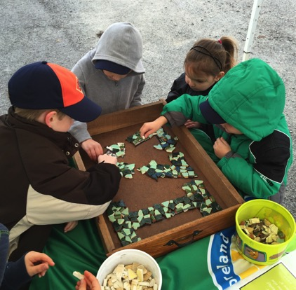
Theme: #BeRecycled
  “#BeRecycled” invites individuals to actively live a recycled lifestyle.
  We encourage everyone to commit to the “Reduce. Reuse. Recycle,” mantra in every aspect of their lives – at home, at work/school, and on-the-go.
  And, it doesn’t have to stop there. There is an abundance of consumer products for purchase that are made from recycled content – make a pledge to buy those items over the traditional versions.

Slide 32
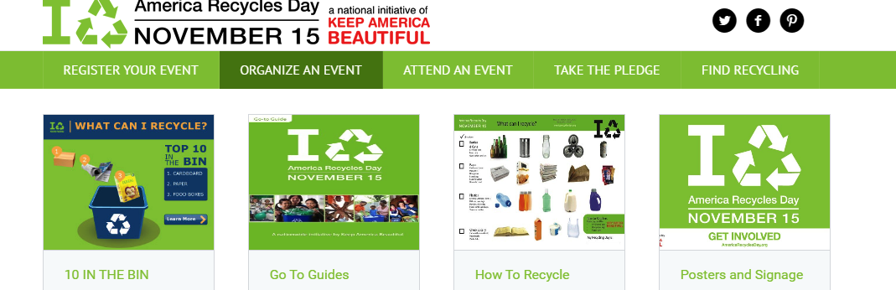
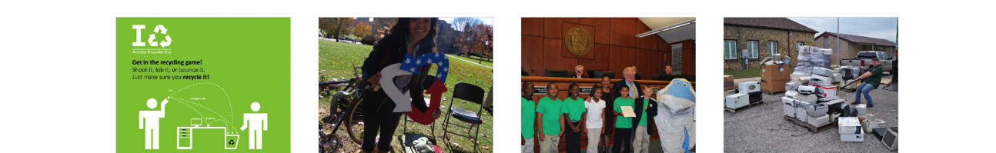
America Recycles Day
Tools & Resources
AmericaReyclesDay.org provides event organizers with a wide variety of tools and resources to make event organizing easy and successful.
Notes:
Add highlights

Slide 33
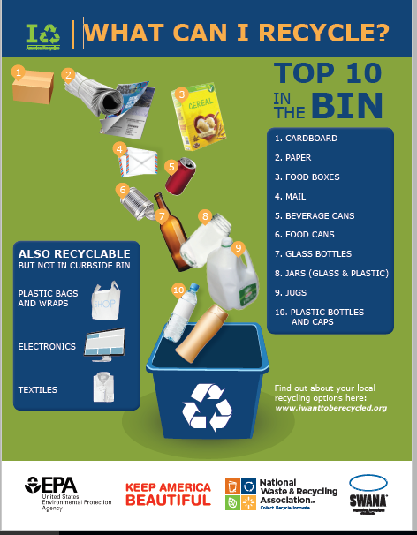
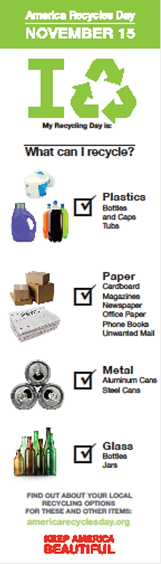
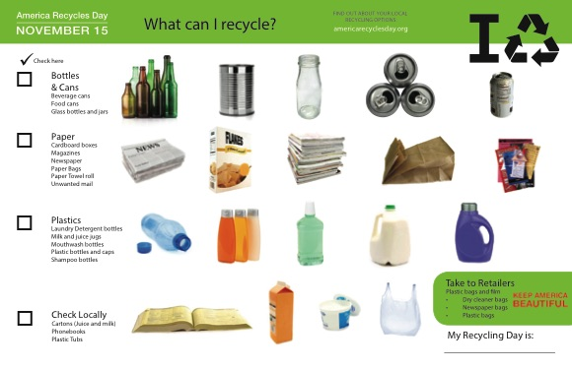
UNIFY, SIMPLIFY AND AMPLIFY

Slide 34

America Recycles Day – November 15
How can YOU get involved?
Host an event – Don’t forget to register!
Take the #BeRecycled Pledge, a promise to actively choose to live a recycled lifestyle by committing to “Reduce. Reuse. Recycle.” in all aspects of daily life.
Share social media posts about America Recycles Day
Notes:
Add highlights

Slide 35


Recycle-Bowl
A fun and engaging national four-week K-12 school recycling competition.
Aimed at igniting a passion for recycling among students across America.
2015 Recycle-Bowl Results
Metric | Result
Schools registered | 1,266
Students/Teachers reached | 689,942
Pounds recycled | 3.9 million
GHG reduced | 5,726 MTCO₂E
Average pounds per capita | 7lbs/capita
Notes:
This year the website was updated! New registration process

Slide 36




Recycle-Bowl
How Will You?
Invite schools in your community to participate
  Competition Dates: October 17 – November 15
  Registration Deadline: October 14
Notes:
Add goals

Slide 37







Eligible: Schools, government agencies, non-profits, colleges and other community organizations.
Multiple bin styles and discounted matching option
Applications open online until Oct 7
More info and apply at bingrant.org

Slide 38

Resources
America Recycles Day - http://americarecyclesday.org/
Recycle-Bowl - http://www.recycle-bowl.org/
Recycling @Work - http://recycle@work.org
National PSA Campaign - www.iwanttoberecycled.org
Notes:
There are lots of ways to get involved with KAB and our behavior change initiatives. Contact our recycling office if you have further questions.

Slide 39





Recycling Department
Brenda Pulley
Senior Vice President, Recycling
Alec Cooley
Director,
Recycling Programs
Tyler Orton
Manager,
Recycling Programs
Giulia Manno
Program Coordinator,
Recycling Programs
Emily White
Marketing Manager, Programs

Slide 40

QUESTIONS?

Slide 41
For more info contact:
Brenda Pulley - bpulley@kab.org
Alec Cooley - acooley@kab.org
Tyler Orton – torton@kab.org

Slide 42

Carlsbad Inn Beach Resort
Notes:
Thanks to our Board member and Advisior – Behavioral Psychologist, Dr. Wesley Shultz for this conservation norms messaging research project example:
Note: My appreciation to the team of CSUSM students who worked on this experiment: Azar Khazian, Michelle Hynan, Joy Francisco, Christine Jarvis, and Jenny Tabanico.

Slide 43

Original Towel Messaging
Old Message:
Help us conserve our national resources!
Notes:
-The old program involved a message placed on a door hanger, which used a sort of “throw in the kitchen sink” approach, by appealing to various motives in a request for guests to reuse towels
-I wanted to develop messages that were more focused, and that targeted specific types of social norms, and see which was most effective by tracking towel usage among rooms with the varying messages

Slide 44

Revised Towel Messaging
New Message:
Many of our guests have expressed to us their approval of conserving energy. When given the opportunity nearly 75% of hotel guests choose to reuse their towels each day.

Slide 45
Carlsbad Inn Beach Resort
  Results
  Number of towels taken out of the room on the first towel replacement day.
Findings: A 25% reduction in the number of towels used!
Source: Schultz, P. W., Khazian, A., & Zaleski, A. (2008). Using normative social influence to promote conservation among hotel guests. Social Influence, 3, 4-23.

