Slide 1
LITTER AND LITTERING BEHAVIOR “How to bring about behavior change”
Wesley Schultz, Ph.D.
Keynote address: Keep Louisiana Beautiful, Annual State Conference. September, 2016. Baton Rouge, LA.

Slide 3
Priming Questions
Q: Where does litter come from?

Slide 4
Priming Questions
Q: What’s the best predictor of whether or not a person will litter?

Slide 5
Definitions
Litter—any misplaced piece of solid waste.
Littering—a person’s behavior that results in misplaced solid waste.

Slide 6
Overview
1. Litter and littering research
2. An Integrated Strategy
3. Studies and examples
4. Applications to KLB

Slide 7
Littering in America
Behavioral observations of ~10,000 individuals in public spaces across the country
10 states, 30 cities, 130 sites
General littering observations
Smoker observations
Intercept interviews (N=112)

Slide 8
Selected Cities by State
State | Urban | Suburban | Rural
California | San Diego | Carlsbad | Ramona
Nevada | Las Vegas | Henderson | Boulder City
Utah | Salt Lake City | West Valley City | Bountiful City
Arkansas | Little Rock | North Little Rock | Maumelle
New Mexico | Albuquerque | Paradise Hills | Rancho
Kentucky | Louisville | Jeffersontown | Prospect
Georgia | Atlanta | Marietta | Cartersville
Illinois | Chicago | Elgin | Fox River Grove
New York | Albany | Plattsburgh | Lake Placid
Vermont | Burlington | South Burlington | Williston
Notes:
8

Slide 9
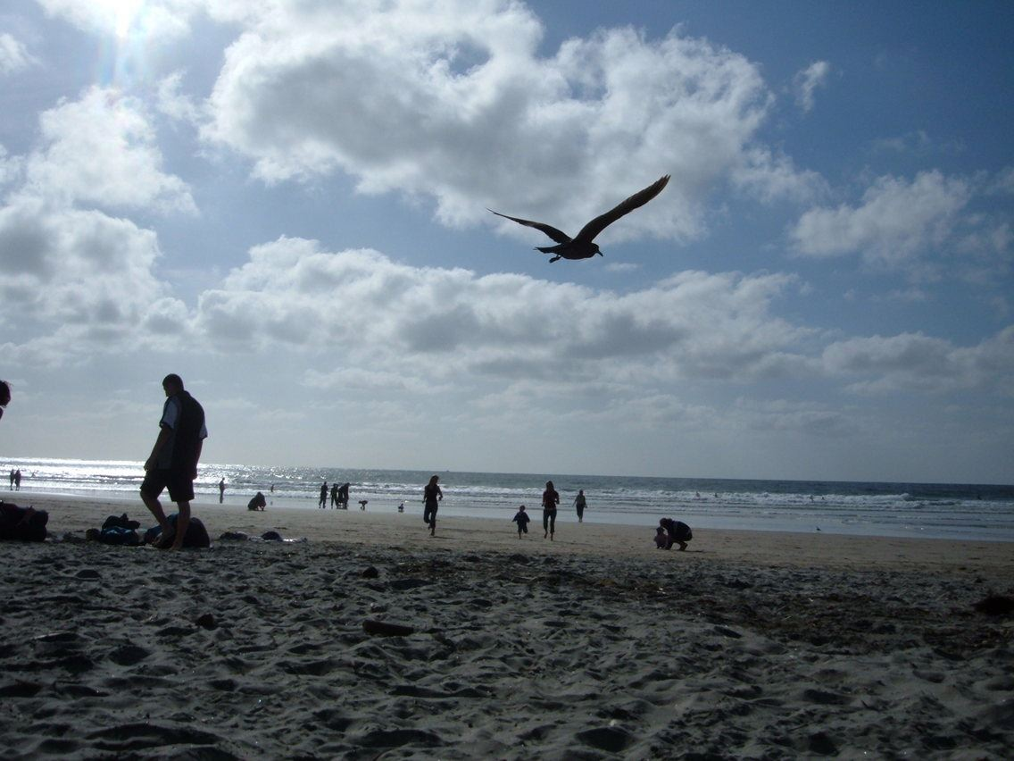
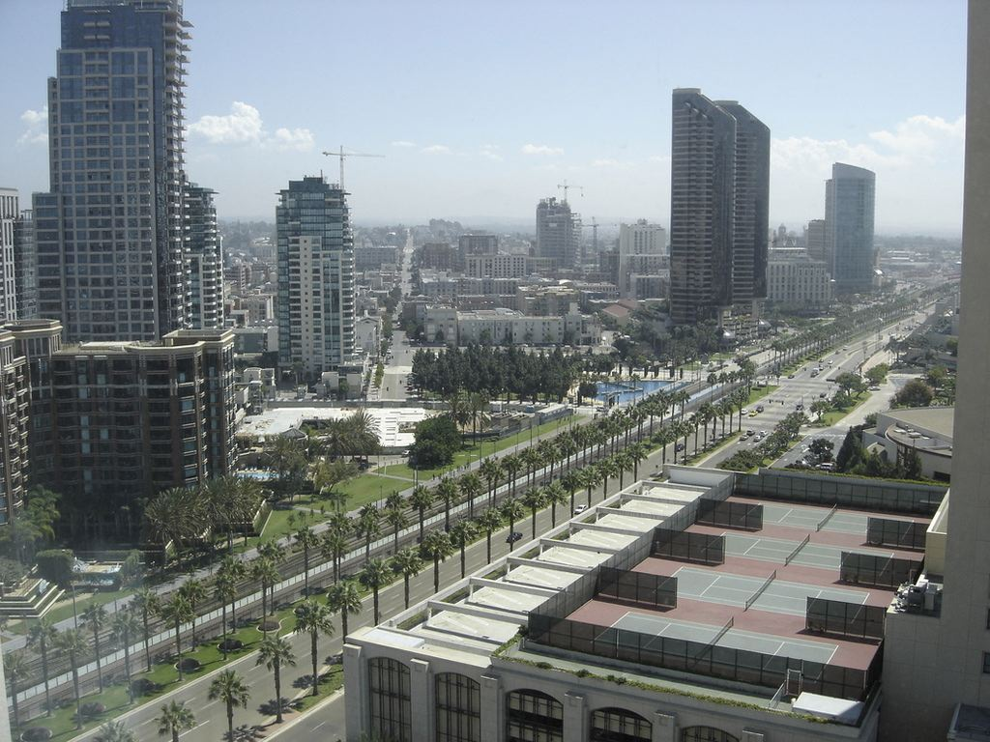
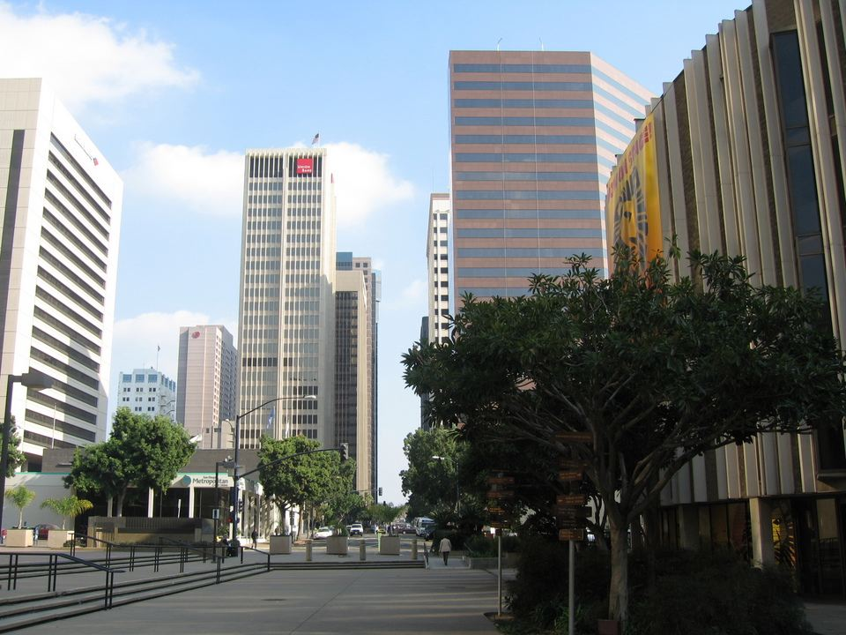
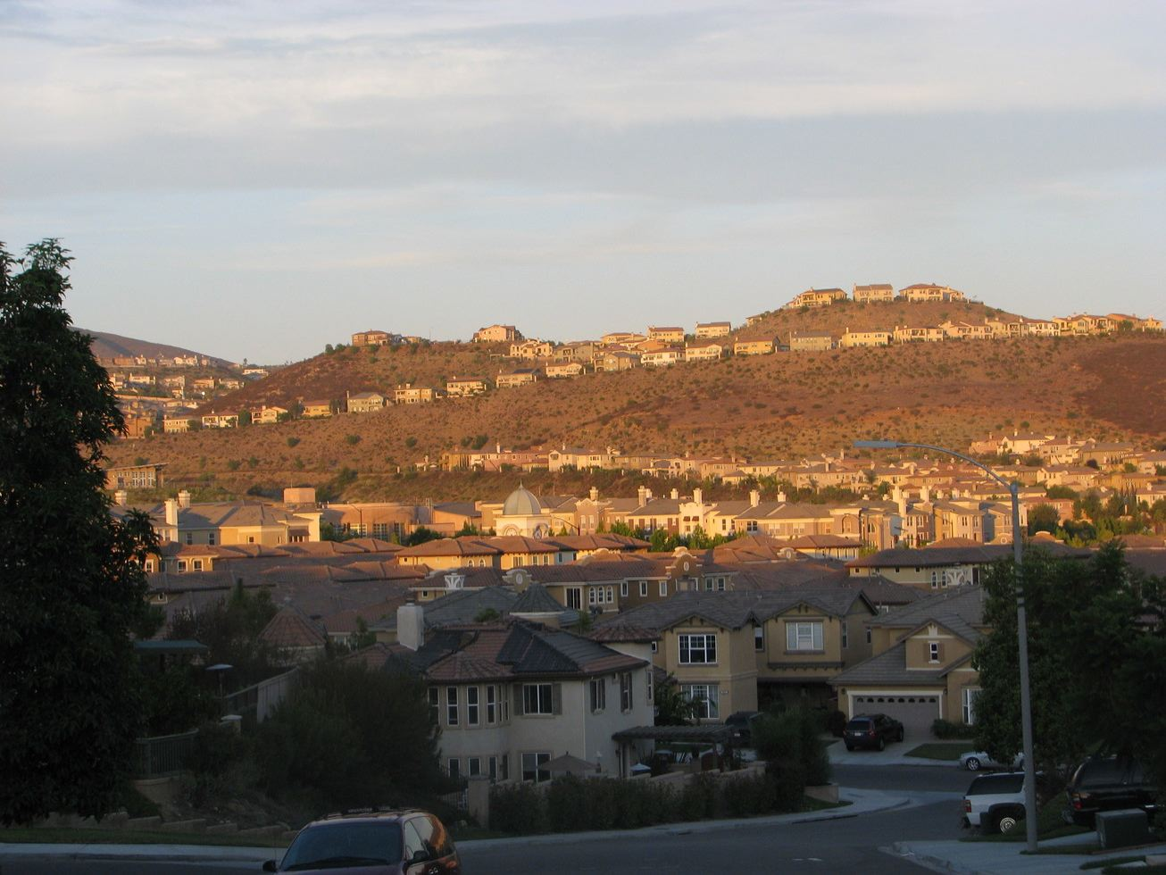
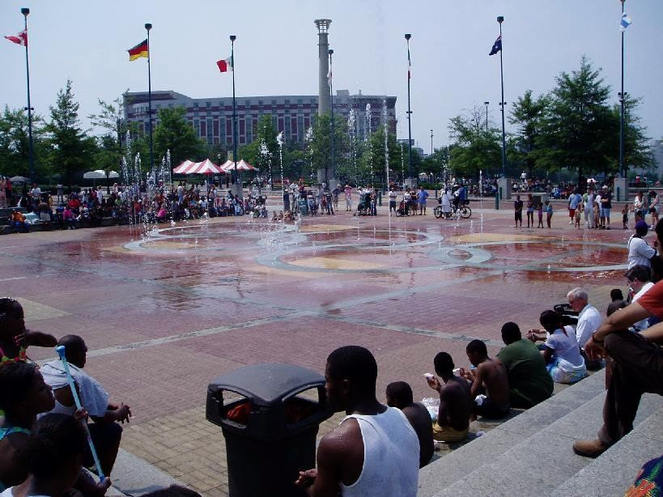
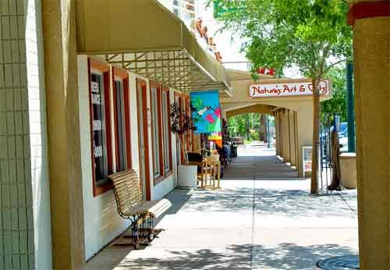
Litter Observation Sites
Notes:
Important: Types of locations predefined. So not a true random sample of all types of locations possible.
9

Slide 10
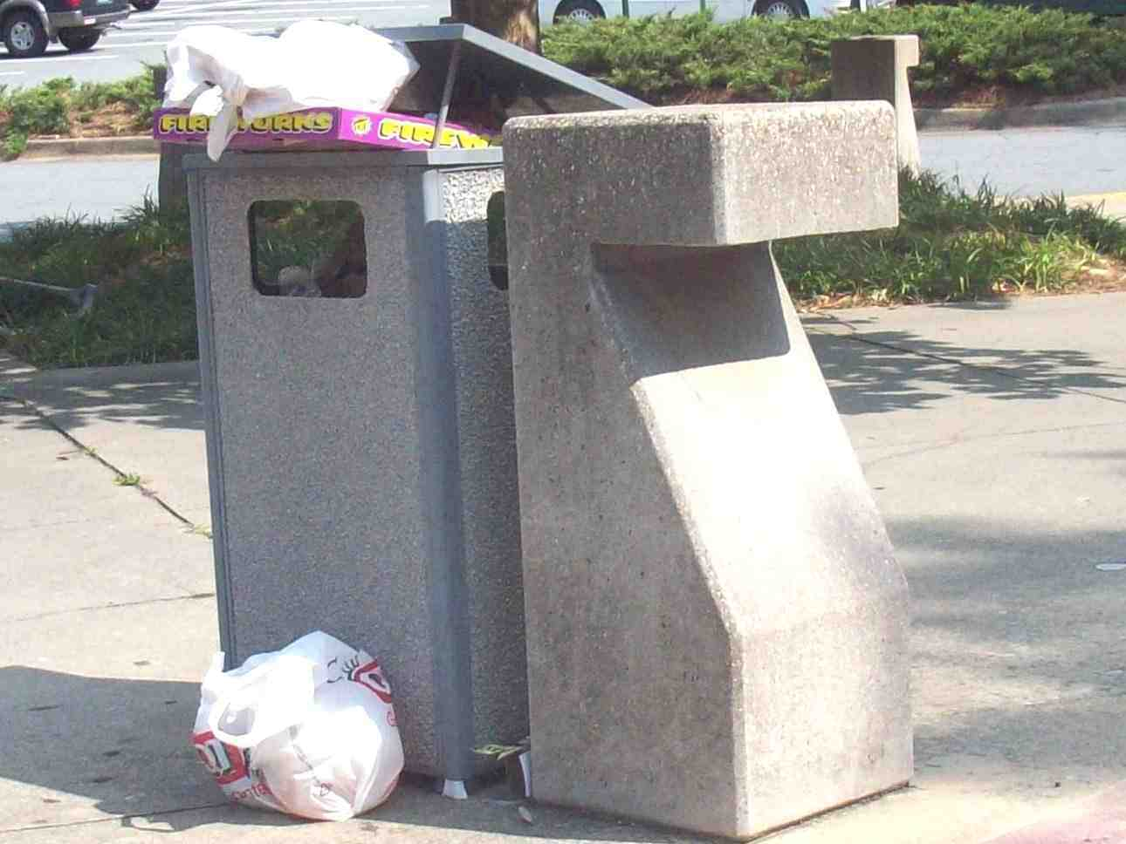
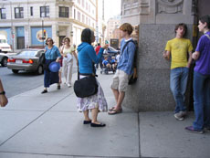
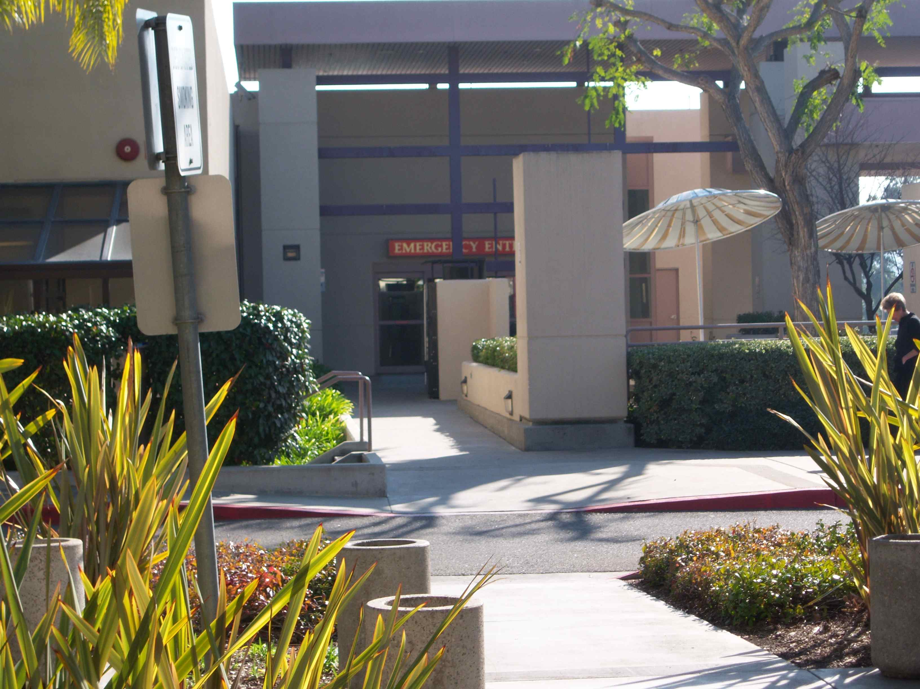
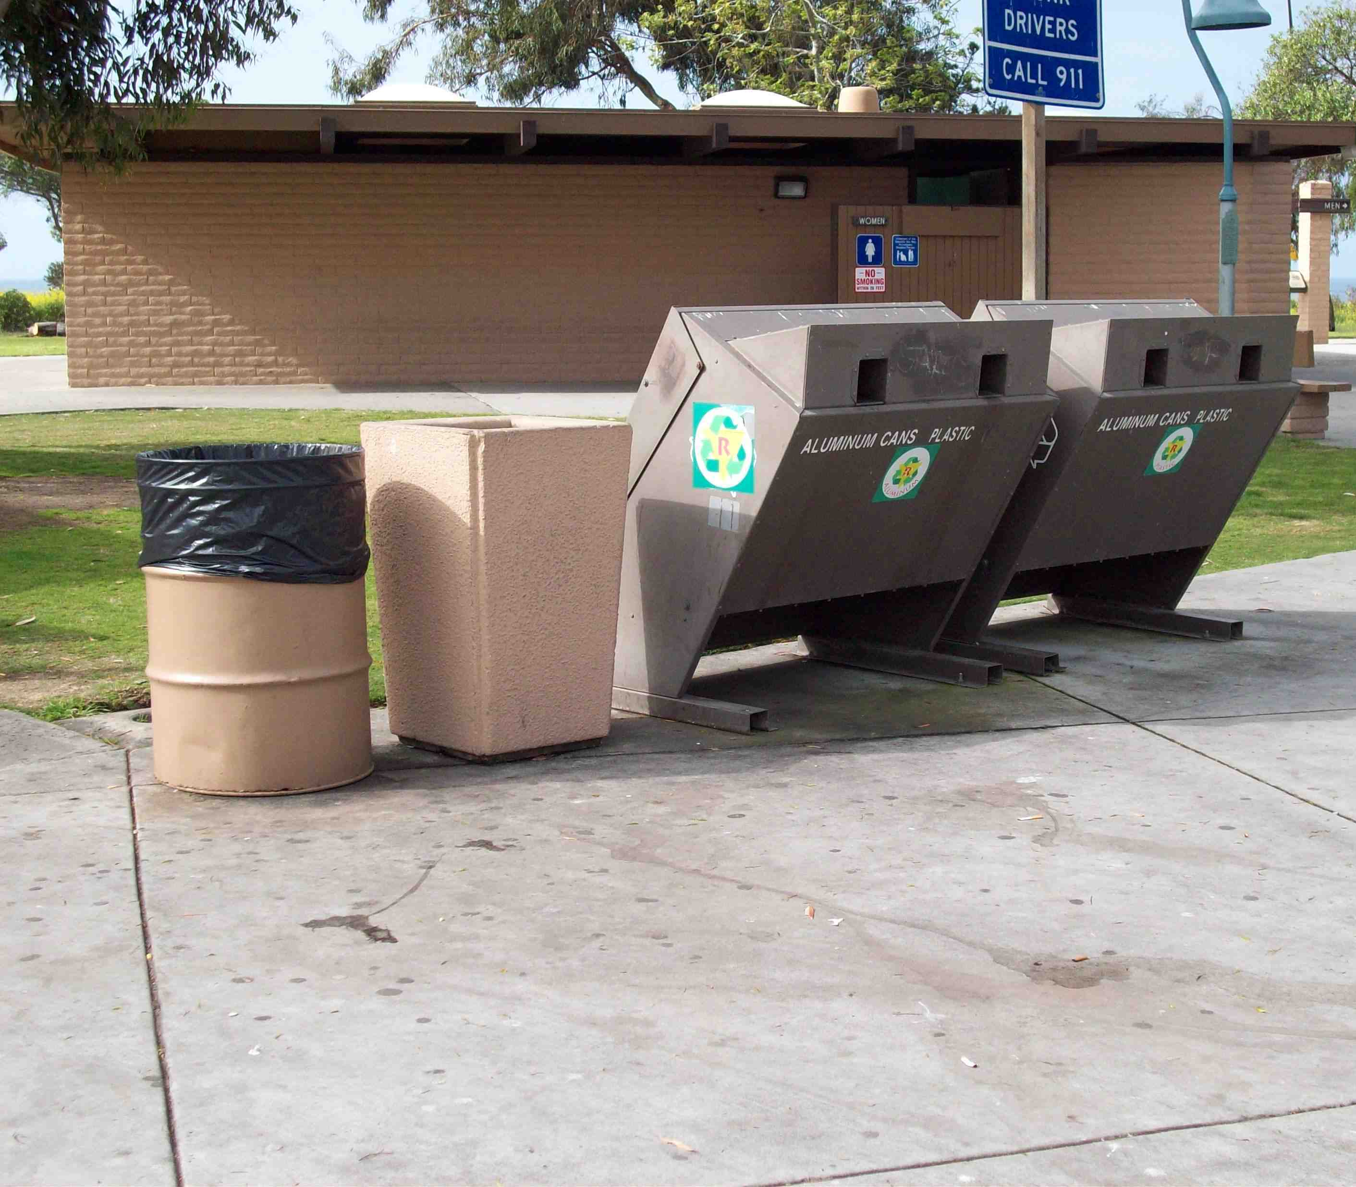
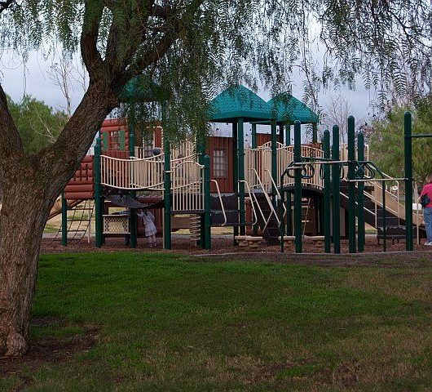
Litter Observation Sites
Notes:
Important: Types of locations predefined. So not a true random sample of all types of locations possible.
10

Slide 11
Litter BUG
Behavioral Understanding Guide
Codesheet and protocol for observing and quantifying littering
Published in peer-reviewed journal (2013)
Randomly select individual
Litter BUG codes:
Individual age, gender, group, other characteristics
Disposals: materials, strategies

Slide 12
Litter BUG

Slide 13
Results
Trash receptacles are widespread
130 sites, 118 accessible receptacles (91%)
Uncovered cans, covered, dumpster
Ash receptacles are less common
43 ash alone, 18 tr/ash combo (47%)
Recycling containers very uncommon
16 sites had at least one recycling bin (12%)
California (8), Vermont (5), Illinois (2), New Mexico (1)
Notes:
Recycling cities: San Diego, Carlsbad, Williston VT, Burlington VT, Fox River Grove IL, Elgin IL, Albequerque NM.
13

Slide 14
Results
Litter is widespread
Of the 130 sites, only two had defined observation areas that were clean of litter
Notes:
14

Slide 15
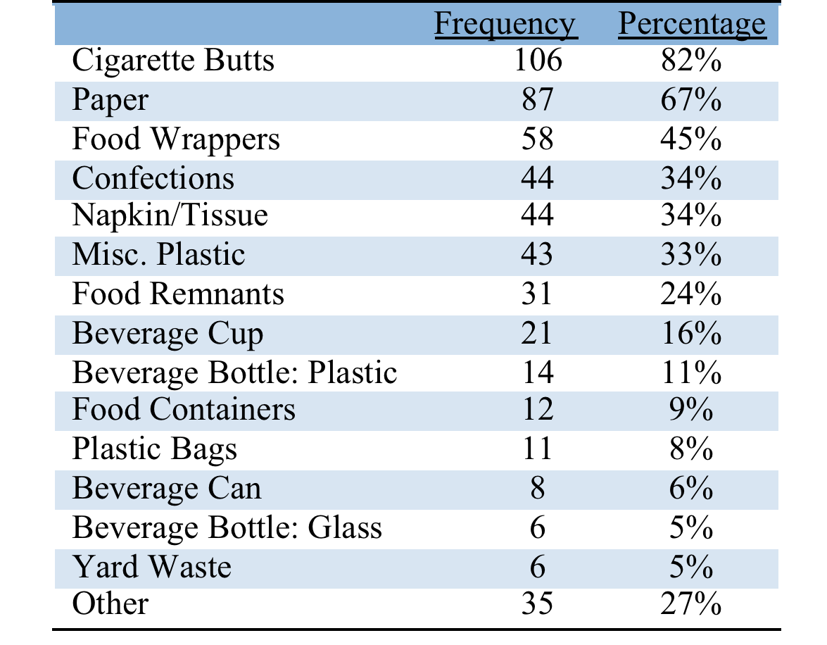
Results
Number of Sites (out of 130) with Existing Litter by Types
Notes:
Other: diapers, dog waste, fishing gear, clothing, and children’s toys.
15

Slide 16
Results
General Litter Observations
17% of all disposals were improper (litter)
4% of all individuals littered
Observation | Frequency | Percentage
Left site with no object | 2,471 | 28%
Left site with object | 4,534 | 50%
Disposed of an object | 1,962 | 22%
- Proper | 1620 | 83%
- Litter | 342 | 17%
TOTAL | 8990
Notes:
16

Slide 17
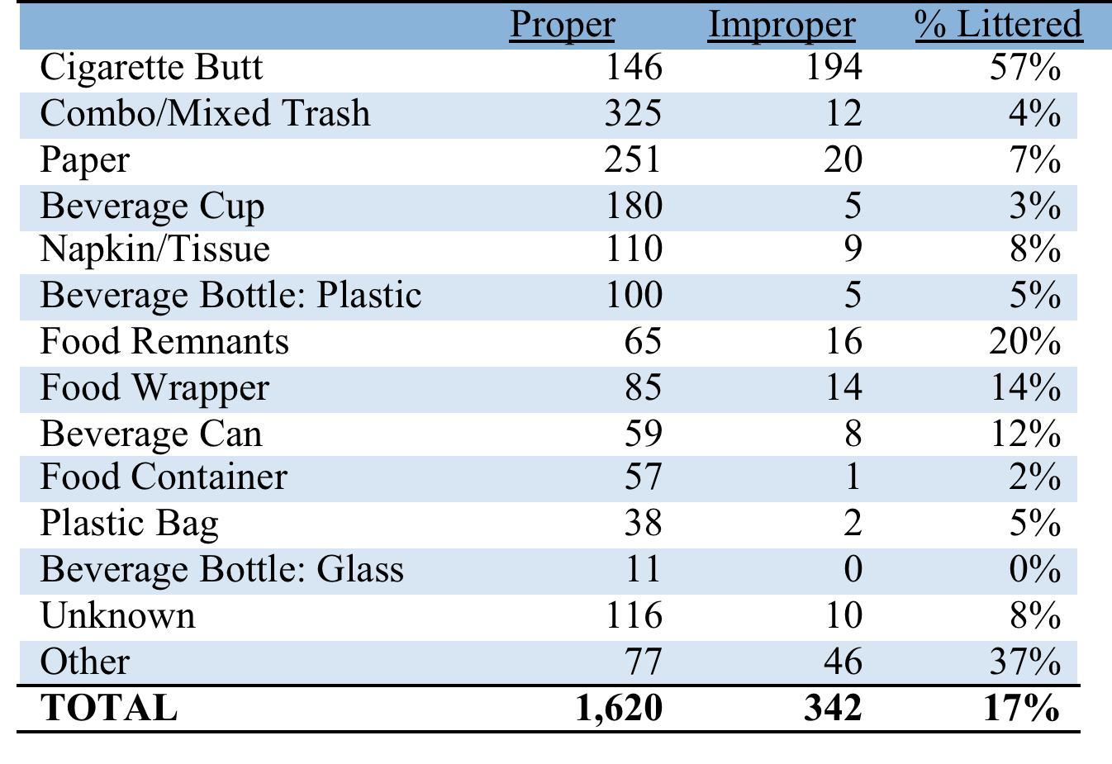
Results
Type and Frequency of Disposed Objects
Notes:
Other: pet waste, candy and other confections, matches and cigarette lighters, diapers, straws, chewing tobacco, and miscellaneous product packaging
like price tags, foil wrappers, and twist ties.
17

Slide 18
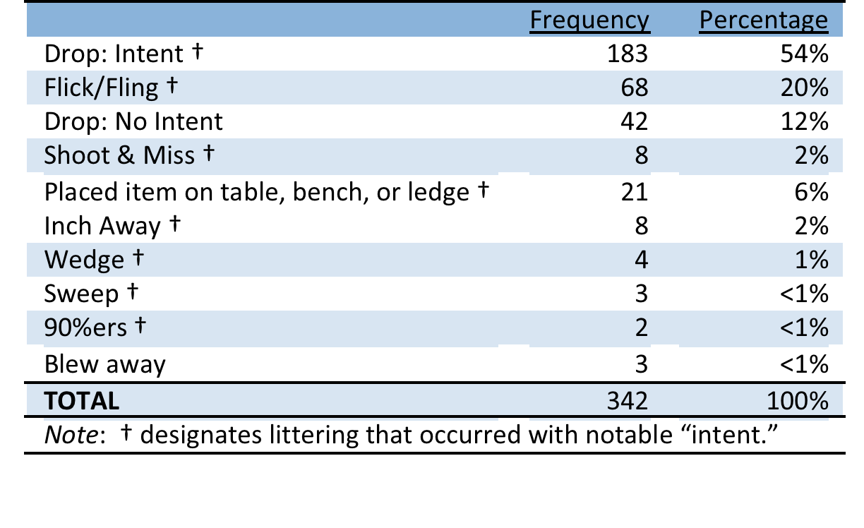
Results
The majority (87%) of observed littering was done with notable intent
Notes:
18

Slide 19
Results
Predicting Littering
Individual-level:
- age (negatively related to littering)
- distance to receptacle (positively related)
- Not gender, group, time of day
Notes:
19

Slide 20
Results
Context-level
- Number of receptacles (more receptacles less litter).
Presence of existing litter (more litter, more littering).
Not weather, signage, site type, crowdedness, temperature
Notes:
20

Slide 21
Recommendations
An Integrated Strategy (in priority order)
1. Clean up existing litter
2. Provide expanded (and more convenient) infrastructure
3. Motivational messages (done right)

Slide 22
Recommendations
1. Clean-up existing litter
If you can only do one thing, do THIS!
Littering is more common in littered environments
Consistent and ongoing clean-up efforts
Beautify through attractive landscaping and infrastructure
Placing a sign in a littered environment will only make things worse
Notes:
Cleaning up littering without making changes in infrastructure will produce only short-term effects.
Norm activation effect (Kaiser, 2009; Schultz, 2009).

Slide 23
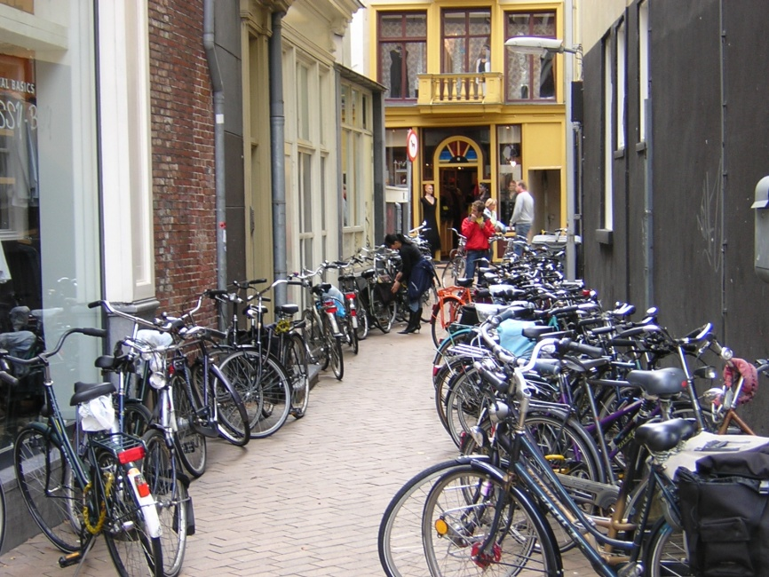
Keizer et al. (2012)
N=424
Flyer attached to handlebar
of bicycle
- % people littered the flyer.

Slide 24
Keizer et al. (2012)

Slide 25
Recommendations
2. Behavioral Affordances
Availability and convenience of receptacles strongly predictive of littering
Particularly for ash receptacles
Need for recycling infrastructure
Opportunities for sponsored or branded receptacles
Notes:
Cleaning up littering without making changes in infrastructure will produce only short-term effects.

Slide 26
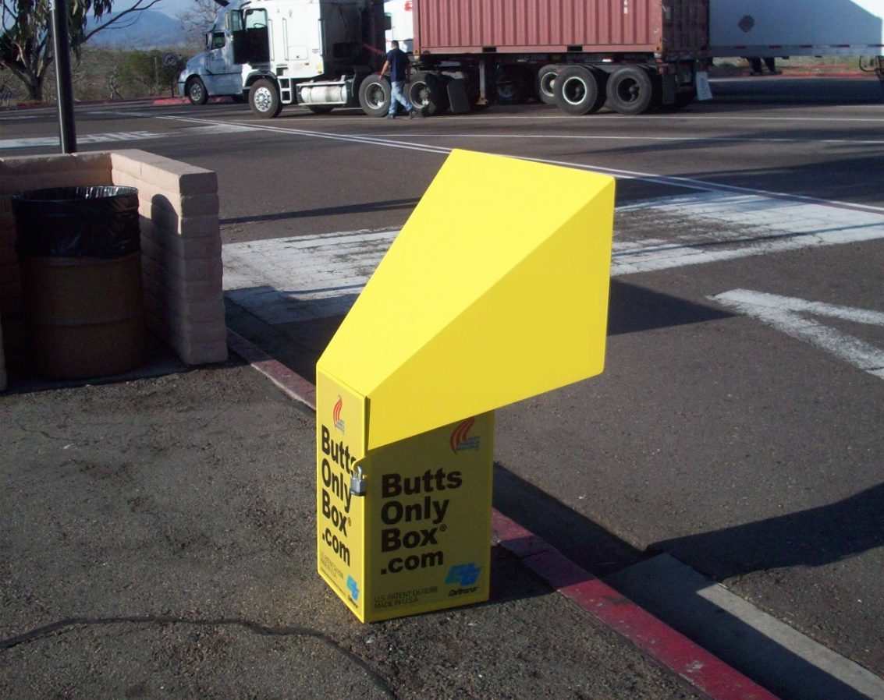
CA Rest Areas
This research was conducted in cooperation with Caltrans and KAB to test the effect of butt box ash receptacles on cigarette smoker disposal behavior.

Slide 27
Method
1,211 smokers were observed at 16 rest areas across California
Pre- and post-installation observations were made at 11 treatment sites and 5 control sites

Slide 28
Results: Proper Disposal
Proper disposal increased from 48% to 54%

Slide 29
2. Infrastructure
Adding collection bins increases proper disposal
Especially in clean environments
Effective because reduces the distance to receptacle
Placement is critical!
Observe and design prior to implementation
Notes:
Cleaning up littering without making changes in infrastructure will produce only short-term effects. What to avoid: messages about not littering in littered context.

Slide 30
Recommendations
3. Awareness and motivational campaigns (done right)
Littering is largely a function of individual motivation
Messages that show littering as common will undermine litter prevention
Messages of social disapproval for littering, and preference for clean communities
Notes:
Cleaning up littering without making changes in infrastructure will produce only short-term effects. What to avoid: messages about not littering in littered context.

Slide 31
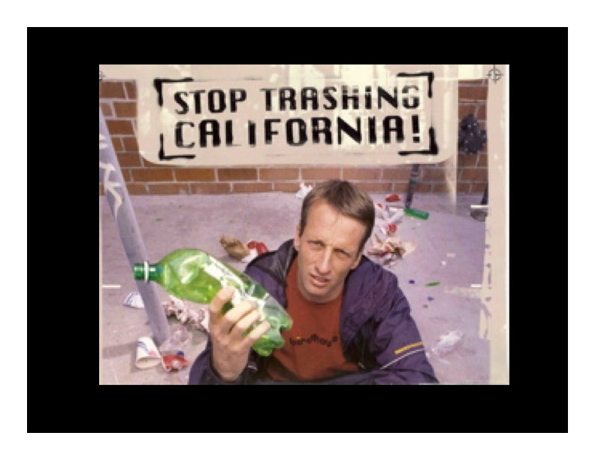

Slide 32
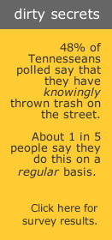

Slide 33
Conclusions
Litter originates from behavior (most of which is intentional)
Littering can be reduced
An Integrated Strategy:
1. Clean up existing litter
2. Expand infrastructure
3. Motivational messaging

Slide 34
KAB Behavior Change System: 5 Step Management Process
1
Get the Facts
5 Step
Management Process
5
Provide Positive Reinforcement
2
Involve the People
4
3
Focus on Results
Develop a Plan
* Part of KAB Behavior System
Notes:
1. Get the Facts
Research the needs for your community. Interview field professionals and interested stakeholders, conduct surveys, focus groups, literature reviews, and gather data through third-party research. Then assemble all the data to help target an approach to individual and community change.
2. Involve the People
Identify the people who have the most influence over the identified target areas. Let them know what you would like to do. Determine how it can match their interests, and capitalize on that to develop the program. Let them involve people they know or with whom they work. The volunteer network will spread. Delegation is the key.
3. Develop a Plan
Once the leadership and other key individuals agree, develop a plan of action. The plan should address the who, what, where, when and why. Identify applicable tools, contacts, and resources, including those provided by KAB.
4. Focus on Results
The goal is to achieve measurable community improvement results. Focus on results that show a change in behavior such less litter, a reduction in graffiti vandalism, increased recycling, etc. Results may also be shown through number of volunteers, trees planted, or bags of litter collected. Identify and focus on all results.
5. Provide Positive Reinforcement
To motivate individuals to sustain environmental and quality-of-life changes in the community, provide regular feedback. Communicate specific and targeted results to neighborhoods, the business community, and residents. Involve the media, when appropriate, in sharing positive results more broadly. Give all volunteers and supporters of your organization appropriate recognition. People must feel positive about their efforts if they are to sustain their interest.

Slide 35
Get the facts
Prioritize behaviors
Littering example
Littering in public spaces
Litter originates from people

Slide 36
Develop a plan
Barriers and benefits
Draw on tools from behavioral science
Personal contact, where possible

Slide 37
Strategy Development
Behavior Change
Remove Barriers
Personal Contact
Tools from Social Sciences
Enhance Benefits

Slide 38
Barriers
“Anything that reduces the probability of a person engaging in the target behavior.”

Slide 39
Benefits
“Anything that increases the probability of a person engaging in the target behavior.”

Slide 40
Identify Barriers and Benefits
Graphic From: Schultz, P. W. (2014). Strategies for promoting proenvironmental behavior: Lots of tools but few instructions. European Psychologist, 19, 107-117. [Special Issue on Sustainability].

Slide 41
Identify Barriers and Benefits
Graphic From: Schultz, P. W. (2014). Strategies for promoting proenvironmental behavior: Lots of tools but few instructions. European Psychologist, 19, 107-117. [Special Issue on Sustainability].

Slide 42
Develop Strategy
Behavior Change
Remove Barriers
Personal Contact
Tools from Social Sciences
Enhance Benefits

Slide 43
Conclusions
Litter originates from behavior (most of which is intentional)
Littering can be reduced
An Integrated Strategy:
1. Clean up existing litter
2. Expand infrastructure
3. Motivational messaging

Slide 44
END

Slide 46
Group Activity
Behavior prioritization
Barriers and benefits

Slide 47
Group Activity
Behavior prioritization
Barriers and benefits

Slide 48
Group Activity
1. Behavior prioritization (5-10 minutes)
brainstorming target behaviors that are linked with the goal
Ranking in terms of importance and probability of change
Select 1

Slide 49
Group Activity
2. Barriers and benefits (5-10 minutes)
Brainstorming barriers to the target behavior
Brainstorming motivational benefits

Slide 50
Group Activity
Litter prevention
Recycling
School-based programs
Beautification of public spaces
Added topic
Added topic

